Slide 1
Introduction to Natural Language Processing
Chia-Yi Su
Department of Electronic Engineering
National Kaohsiung University of Science and Technology

Slide 2
Syllabi

Slide 3
Course Outline
Basic Knowledge on Natural Language Processing
Applications of Natural Language Processing
Word Vector
Neural Network (Including Relative Math Derivation)
Dependency Parsing
Recurrent Neural Network, Variants of Recurrent Neural Network, and Language Model
Machine Translation
Contextual Representation
Dialog System (Including MultiModal Dialog System)

Slide 4
Online Courses
CS224n: Natural Language Processing with Deep Learning – Stanford University
https://web.stanford.edu/class/archive/cs/cs224n/cs224n.1194/ (2019 Edition)
CMU 11-411: Natural Language Processing – CMU
http://demo.clab.cs.cmu.edu/NLP/
CMU 11747: Neural Network for NLP – CMU
http://phontron.com/class/nn4nlp2021/index.html
CMU 11-777: MultiModal Machine Learning - CMU
https://cmu-multicomp-lab.github.io/mmml-course/fall2020/

Slide 5
Textbooks
Deep Learning
Goodfellow et al., Deep Learning.
https://www.deeplearningbook.org/
Zhang et al., Dive into Deep Learning.
https://d2l.ai/
Natural Language Processing
Dan Jurafsky and James H. Martin, Speech and Language Processing.
https://web.stanford.edu/~jurafsky/slp3/

Slide 6
Today’s Agenda
Natural Language Processing
Can We Automate Scientific Reviewing?
The Design and Implementation of XiaoIce, an Empathetic Social Chatbot
Recipes for building an open-domain chatbot
Semantically-Aligned Equation Generation for Solving and Reasoning MathWord Problems
Applications of the GPT-3 Model
Google Assistance
Introduction to Dialog System
Regular Expression
Tools for Natural Language Processing

Slide 7
Natural Language Processing

Slide 8
What is Natural Language Processing?

Slide 9
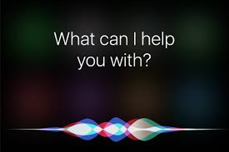
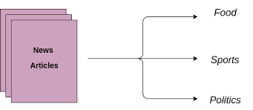
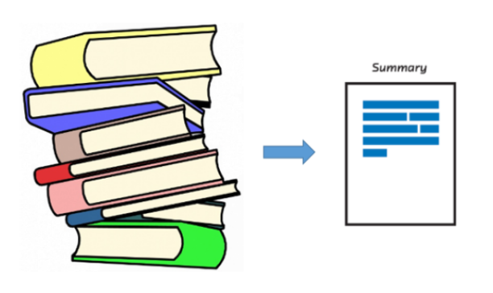
Applications of Natural Language Processing

Slide 10
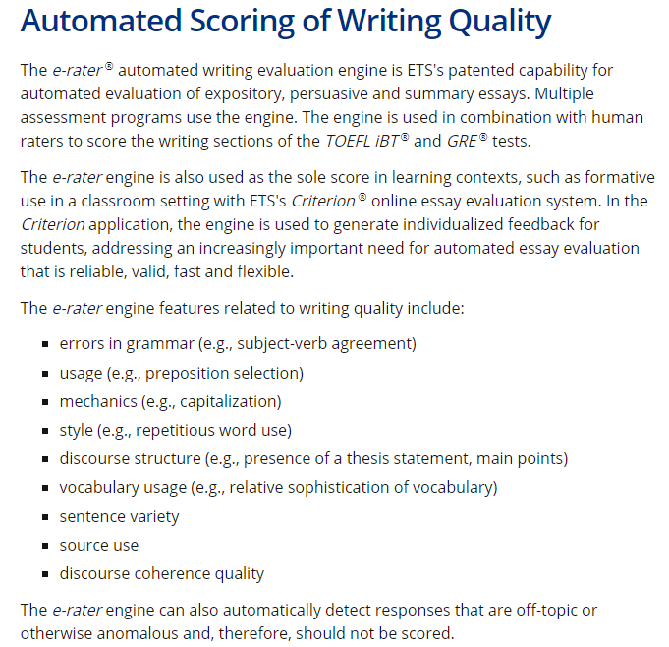
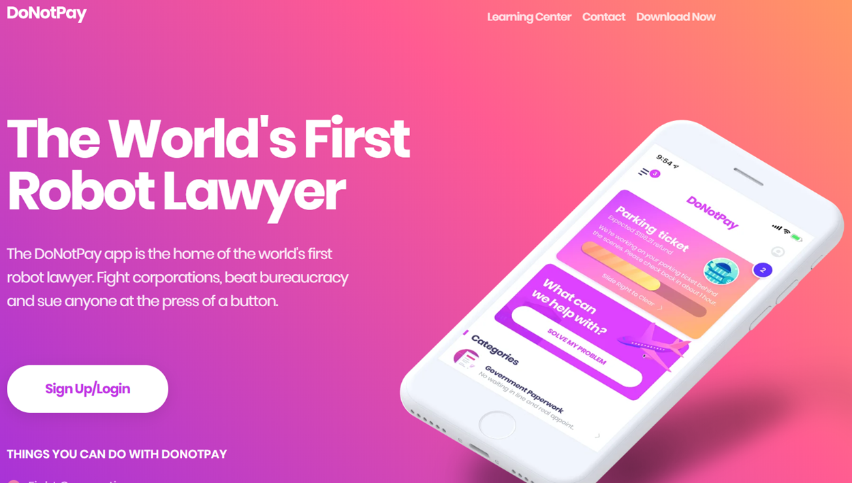
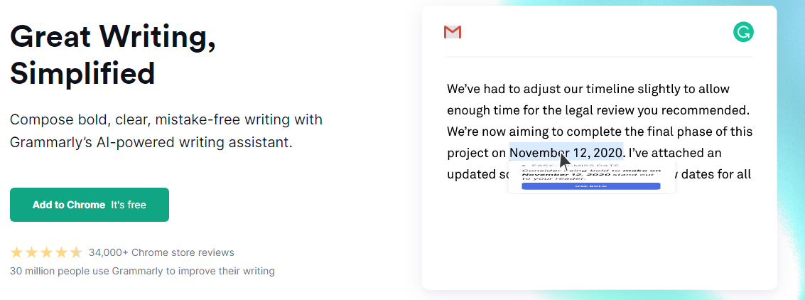
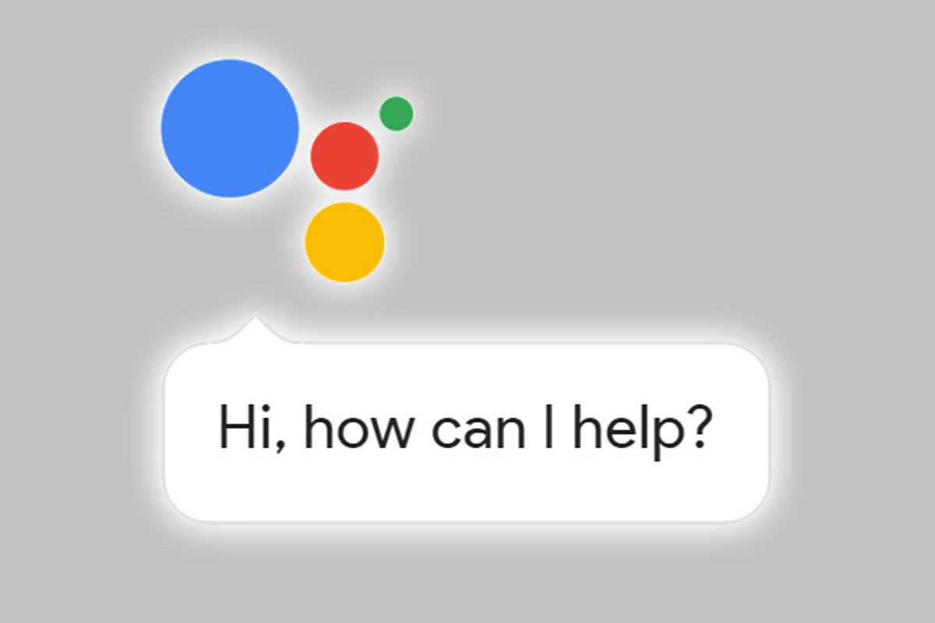
NLP is Everywhere

Slide 11
Evolution of Natural Language Processing
Count-Based Model
Word Representation
Contextual Representation

Slide 12
Evolution of Natural Language Processing
TF & TF-IDF | Co-Matrix | Word2Vec | GPT | BERT | GPT-2 | GPT-3
 |  | Mikolov et al., 2013. | Radford et al., 2018. | Devlin et al., 2018 | Radford et al., 2019 | Brown et al., 2020
Contextual Representation (Transformer)
Word Representation
Statistical Model

Slide 13
Why is NLP hard?
Ambiguity of Natural Language
Polysemy
Formal and Informal Language
Writing Taiwanese in the Chinese Language
SMS Language
Evolution of Language
Difference in Structure
Following the grammar V.S. Not following the grammar

Slide 14
Why is NLP hard? - Example
Ambiguity of Natural Language
88、98、白泡泡（台語：皮膚很白)、水噹噹
你真的是我們的老鼠屎耶!
Steph Curry發火起來可以在一場得40分，非常的強。
Difference in Structure
I am going to watch a movie. < - > I’m ganna watch a movie.
I want to watch a movie. < - > I wanna watch a movie.
https://cdn-images-1.medium.com/max/800/1*gmL2WA-hoXe8HokFZ9wXIA.gif

Slide 15
Corpora Introduction
Corpora
https://github.com/fighting41love/funNLP
https://github.com/InsaneLife/ChineseNLPCorpus
https://github.com/SophonPlus/ChineseNlpCorpus
https://github.com/brightmart/nlp_chinese_corpus
http://asbc.iis.sinica.edu.tw/
Stop Words
https://github.com/goto456/stopwords

Slide 16
Open Datasets for NLP
Question Answering
Rajpurkar et al., Know What You Don’t Know: Unanswerable Questions for SQuAD (SQuAD 2.0).
Natural Language Inference
Zellers et al., SWAG: A Large-Scale Adversarial Dataset for Grounded Commonsense Inference.
Bowman, large annotated corpus for learning natural language inference
Natural Language Understanding
Wang et al., GLUE: A MULTI-TASK BENCHMARK AND ANALYSIS PLATFORM FOR NATURAL LANGUAGE UNDERSTANDING.
Visual Question Answering
https://visualqa.org/challenge

Slide 17
Tokenization
Tokenization is to tokenize the sentence into several meaningful words.
Try to think about the following sentences as far as computers are concerned.
郭台銘創立了鴻海公司。
郭台銘 創立 了 鴻海 公司 。
What’s the name of the 郭台銘’s company?
Tokenization is the same as how human beings read the article. Human beings always break down the article into several passage.

Slide 18
Recent Trends of Word Tokenization
Problems of Tokenization: Prone to have the OOV problem
Novel Method: WordPiece Tokenization (Schuster and Nakajima, 2012; Wu et al, 2016.)

Slide 19
Sequence Label
Labeling each word with a token
Applications of Sequence Label
Name Entity Recognition
Part of Speech
Slot Filling

Slide 20
Text Lemmatization
Mainly used in English
Transforming the words into the radical
E.g.: Went -> Go

Slide 21
Stop Word Processing
Removing the words whose term frequency is to high such as a, the and an.
Stop Words may vary according to the tasks.

Slide 22
Encoding Methods: Term Frequency
Counting the number of words that appear in the corpora.
The most basic but the least robust method.
Problem: Prone to be influenced by stop words

Slide 23
Encoding Methods: TF-IDF
Formula of TF-IDF
tf-idf = $tf ∗idf\left(t\right),$where tf is term frequency
idf(t) = $\log\left(\frac{nd}{nd\left(t\right)}\right)$, where nd = number of documents, nd(t) = number of documents that contain the term t

Slide 24
Can We Automate Scientific Reviewing?
Yuan et al., Arxiv, 2021.

Slide 25
Summary Example: BERT (Devlin et al., 2018)

Slide 26
Paper Review Example: BERT (Devlin et al., 2018)

Slide 27
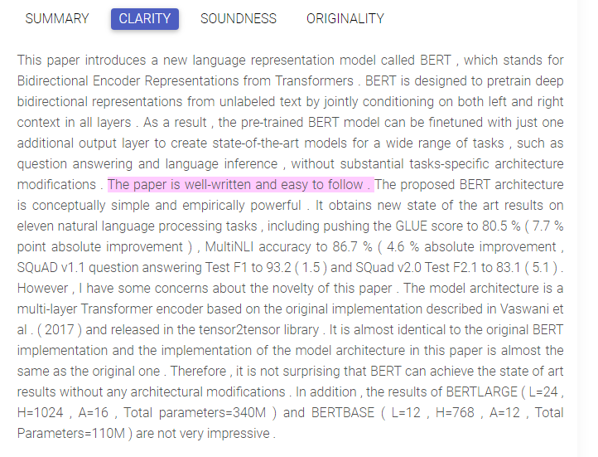
Paper Review Example: BERT (Devlin et al., 2018)

Slide 28
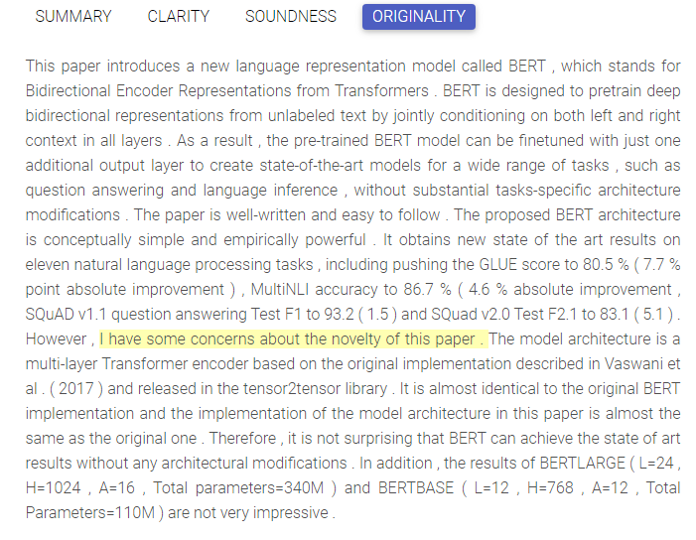
Paper Review Example: BERT (Devlin et al., 2018)

Slide 29
The Design and Implementation of XiaoIce, an Empathetic Social Chatbot
Zhou et al., Computational Linguistics, 2020.
Notes:
https://youtu.be/3tsA15tJ2NI

Slide 30
Example: Singing
Notes:
https://www.youtube.com/watch?v=3tsA15tJ2NI&ab_channel=Xiaoice

Slide 31
Example: Chat
Notes:
https://www.youtube.com/watch?v=z3jqIGT-kmg

Slide 32
Recipes for building an open-domain chatbot
Roller et al., Arxiv, 2020.

Slide 33
Demonstration
https://ai.facebook.com/blog/state-of-the-art-open-source-chatbot/

Slide 34
Applications of the GPT-3 Model

Slide 35
HTML Layout Generation
https://twitter.com/sharifshameem/status/1282676454690451457
Web Generation
https://twitter.com/jsngr/status/1287026808429383680?s=20
https://stripe.com/
Generate & Update the Graph
https://twitter.com/plotlygraphs/status/1286688715167936512
Others
https://github.com/elyase/awesome-gpt3

Slide 36
Semantically-Aligned Equation Generation for Solving and Reasoning MathWord Problems
Chiang and Chen, ACL, 2019.

Slide 37
Model Architecture

Slide 38
Google Assistance

Slide 39
Demonstration
Notes:
https://www.youtube.com/watch?v=ARA0AxrnHdM&list=PLvS_0NFzXkhOfG-75L9c8JPcDogdWWOk9&index=292&ab_channel=Google

Slide 40
Google Duplex
Notes:
https://youtu.be/D5VN56jQMWM?t=71

Slide 41
Introduction to Machine Learning

Slide 42
Types of Machine Learning
Supervised Learning
Regression
Classification
Unsupervised Learning
Clustering
Self-Supervised Learning
Self-supervised learning: The dark matter of intelligence
Transfer Learning
Reinforcement Learning
Imitation Learning

Slide 43
Introduction to Dialog System

Slide 44
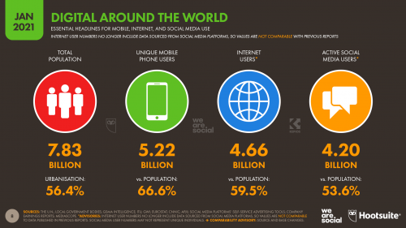
Why Dialog System?
Digital Data of January 2019
Source: https://wearesocial.com/blog/2021/01/digital-2021-the-latest-insights-into-the-state-of-digital

Slide 45
Two Taxonomies of Intelligence Assistance
Taxonomy of Intelligence Assistance
Reactive Assistance
Proactive Assistance

Slide 46
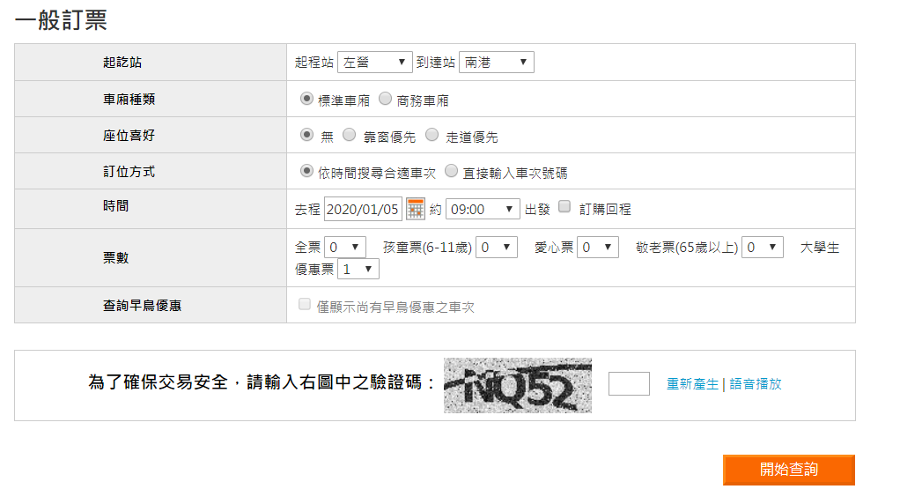
GUI v.s. CUI (Conversational UI)
Source: https://irs.thsrc.com.tw/IMINT/ Source: http://webap.nkust.edu.tw/nkust/f_index.html

Slide 47
Introduction to Dialog System
Natural Language Understanding
Types of Dialog System
Chit-Chat Dialog System
Task-Oriented Dialog System
Flow of Dialog System
Dialog Manager
Natural Language Generation
Domain Classification
Intent Detection
Slot-Filling
Dialog State Tracking
Dialog Policy Making
Output

Slide 48
Dialog System Example
I would like to book a HSR ticket from Kaohsiung to Nangang.
Domain
HSR
Intent
Book a Ticket
Sequence Label
o o o o o o o o B-Depart I-Depart B-Destination I-Destination
I would like to book a HSR ticket from Kaohsiung to Nangang
Dialog State Tracking
Place
Dialog Policy for Agent Action
We have place but we don’t know the preference of seat, departure time etc. The system may return a question which is “what time do you depart?”

Slide 49
Regular Expression

Slide 50
What is regular expression?
Write a rule to match the words.
There are many editors allowing to search the text by using regular expression.

Slide 51
Introduction to Basic Regular Expression
[ ] Match the characters which is included in the square brackets.
[^] Match the characters which is not included in the square brackets.
| or
? The characters before ? are optional.
* The characters before * are not necessary. They can also appear multiple times.
+ The characters before + need to appear at least one time.
. Match any characters.
^ Match the starting point of the sentence.
$ Match the end point of the sentence.

Slide 52
Python Package: RE
Built-in Function of Python
Mainly used to process Regular Expression
It can be used to match and split the string etc.

Slide 53
Tools

Slide 54
NLP Tools
Hugginface Transformer
https://huggingface.co/transformers/
Qi et al., Stanza : A Python Natural Language Processing Toolkit for Many Human Languages
https://stanfordnlp.github.io/stanza/
Pytext
https://github.com/facebookresearch/pytext
Sinica
https://ckip.iis.sinica.edu.tw/service/corenlp/ (Core NLP)
https://ckip.iis.sinica.edu.tw/service/transformers/ (Pre-Trained Transformer)
Jieba Tokenization System
https://github.com/fxsjy/jieba

Slide 55
ML Tools
Pytorch
https://pytorch.org/
Tensorflow
https://www.tensorflow.org/
Scikit-Learn
https://scikit-learn.org/stable/
Numpy
https://numpy.org/
Pandas
https://pandas.pydata.org/

Slide 56
References
D.Manning et al., Foundations Of Statistical Natural Language Processing
陳縕儂, 對話機器人的腦子與靈魂 Bot's Brain and Soul, PyConTW2017
Dan Jurafsky and Chris Manning, “Natural Language Processing”, Stanford Online
Python RE Package Document

