Slide 1
Advanced Word Vector and Introduction to Neural Network
Chia-Yi Su
Department of Electronic Engineering
National Kaohsiung University of Science and Technology

Slide 2
Course Outline
Basic Knowledge on Natural Language Processing
Applications of Natural Language Processing
Word Vector
Neural Network (Including Relative Math Derivation)
Dependency Parsing
Recurrent Neural Network, Variants of Recurrent Neural Network, and Language Model
Machine Translation
Contextual Representation
Dialog System (Including MultiModal Dialog System)

Slide 3
Today’s Agenda
Glove: Global Vectors for Word Representation
Evaluation of Word Vector
Introduction to Classification
Neural Network
Name Entity Recognition
Discussion on Word Vector

Slide 4
Glove: Global Vectors for Word Representation
Pennington et al., ACL, 2014.

Slide 5
Glove (Pennington et al.): Introduction
Two different classes of methods for word embedding
count-based method (e.g. PMI)
window-based models (e.g. Skip-Gram)
Count-Based Method
makes good use of global information
However: Only performs well on similarity tasks
Window-Based Models
Fail make use of global information
However: perform well on many tasks
GLOVE is trained on global information. It outperforms current model as well.

Slide 6
Glove Model: Motivation

Slide 7
Glove Model: Motivation (CONT.)

Slide 8
Introduction to Notation
X: Matrix of word co-occurrence count
$X_{ij}$: Number of times word j occurs in the context of word i
$X_{i}$: Number of times any word appears in the context of word i which is equal to $\sum_{k}{X_{ik}}$
$P_{ij}$: Probability of word j appears in the context of word i which is equal to $P\left(j|i\right)=\frac{X_{ij}}{X_{i}}$

Slide 9
Summary of above Table
Suppose we are interested in Thermodynamics. Let i = ice, j=steam, k = various probe words.
k related to ice but not steam whose $\frac{P_{ik}}{P_{jk}}$would be large, as we show in the table.
k related to steam but not ice whose $\frac{P_{ik}}{P_{jk}}$would be small, as we showed in the table.
k related to both or neither whose $\frac{P_{ik}}{P_{jk}}$would be approximate to 1, as we showed in the table.
According to above summary, the paper (Pennington et al.) showed the importance of the co-occurrence window.

Slide 10
Formula Derivative
$F\left(w_{i},w_{j},{\tilde{w}}_{k}\right)=\frac{P_{ik}}{P_{jk}}$, where w are word vectors and $\tilde{w}$will be discussed later. F depends on a lot of unspecific factors.
$F\left(w_{i}−w_{j},{\tilde{w}}_{k}\right)=\frac{P_{ik}}{P_{jk}},$since the vector space is linear, we can do the vector difference. For now, F only depends on the difference of the two target words.
$F\left({{(w}_{i}−w_{j})}^{T}{\tilde{w}}_{k}\right)=\frac{P_{ik}}{P_{jk}}$, the right-hand side is scalar, while the left-hand side is vector. It would obfuscate the linear structure that we try to capture so we do the dot product on the left-hand side.
The F should satisfy the homomorphism so the formula should equal to
$F\left({{(w}_{i}−w_{j})}^{T}{\tilde{w}}_{k}\right)=\frac{F\left(w_{i}^{T}{\tilde{w}}_{k}\right)}{{F(w}_{j}^{T}{\tilde{w}}_{k})}$, where $F\left(w_{i}^{T}{\tilde{w}}_{k}\right)=P_{ik}=\frac{X_{ik}}{X_{i}}$

Slide 11
Formula Derivative
The solution to above step is F=exp so our formula would be
$w_{i}^{T}{\tilde{w}}_{k}=\ln{P_{ik}}=\ln{X_{ik}−\ln{X_{i}}}$
Since $\ln{X_{i}}$ is independent of k so we can absorb it into bias $b_{i}.$ Also, the formula will be add additional bias $b_{k}$for ${\tilde{w}}_{k}.$ Hence, our formula would be
$w_{i}^{T}{\tilde{w}}_{k}$ + $b_{k}$ + $b_{i}$ = $\ln{X_{ik}}$ (1)
Problem
log will be divergent whenever the argument is 0.
Resolution
$\ln{X_{ik}}$ +1.
However: this will be the same as the co-occurrence algorithm. Each words have the same weights.
Therefore: this algorithm will be based on (1)

Slide 12
Formula Derivative
The paper (Pennington et al.) employs a way called weighted least square regression model and a weighted function $f\left(X_{ij}\right)$ to resolve the problem. Our cost function is, therefore, as follows.
$J=\sum_{i,j}^{V}{f\left(X_{ij}\right)}{\left(w_{i}^{T}{\tilde{w}}_{k}\text{ + }b_{k}\text{ + }b_{i}\text{ − }\ln{X_{ik}}\right)}^{2}$, where the V is the size of vocabulary.
$f\left(X_{ij}\right)$ should obey the following rules
f(0) is 0.
f(x) should be non-decreasing so that the low frequency words will not be overweighted.
f(x) should not be too large so that the words will not be overweighted as well.

Slide 13
Formula Derivative
Although the tons of the functions satisfy the rule as paper mentioned, the function that works well is as follows,
$f\left(x\right)=\left\{\begin{aligned}{\left(\frac{x}{x_{max}}\right)}^{∝} \\ 1, otherwise\end{aligned}\right.$if x < $x_{max}$
According to the experiment, the paper found $∝$ equals $\frac{3}{4}$has the best result. Interestingly, it is consistent with the experiment in the word2vector paper (Mikolov et al.)

Slide 14
Relationship to Other Model
Recall that in the word vector model (Mikolov et al.), they employed softmax to compute the probability of the word j appears in the context word i. The formula is as follows.
$Q_{i,j}=\frac{\exp\left(u_{j}^{T}{\hat{v}}_{i}\right)}{\sum_{j=1}^{\left|V\right|}{\exp\left(u_{j}^{T}{\hat{v}}_{i}\right)}}$
The global cross-entropy is calculated as follows :
$J=−\sum_{i∈corpus}{\sum_{jεcontext}{\ln{Q_{i,j}}}}$
Since both word i and j probably appear multiple times in the corpus, we can group together in consideration of the efficiency.
$J=\sum_{i=1}^{w}{\sum_{j=1}^{w}{X_{ij}\ln{Q_{i,j}}}}$, where X is a co-occurrence matrix.
The most costly one

Slide 15
Relationship to Other Model
Disadvantage of the cross-entropy loss
Computational Costly
Reason: requires to normalize
The paper (Pennington et al.) employed the least square objective so that we don’t need to normalize. The formula is as follows :
$J=\sum_{i=1}^{w}{\sum_{j=1}^{w}{{f(X}_{ij}){\left(\tilde{P_{ij}}\tilde{Q_{i,j}}\right)}^{2}}}$, where $\tilde{P_{ij}}$=$X_{ij}$and $\tilde{Q_{i,j}}$ = $\exp\left(u_{j}^{T}{\hat{v}}_{i}\right)$ which are all unnormalized term.

Slide 16
Word Analogy Explanation
Two types of word analogy problems
Semantics
Syntax
Semantic Problem
a is to b as c is to _
San Francisco is to California as Chicago is to _
Syntactic Problem
Good is to better as bad is to _
These questions are answered by using
$w_{b}−w_{a}+w_{c}$according to cosine similarity

Slide 17
Experiment on Word Analogies

Slide 18
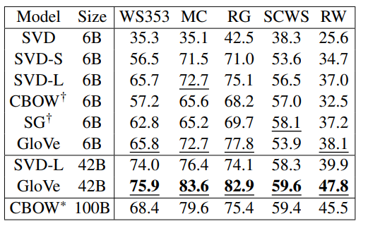
Word Similarity
Although word analogy is a major task, the paper also experiments the task in word similarity. The table below is the result of the experiment.

Slide 19
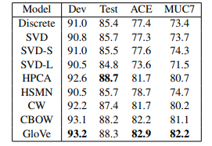
Name Entity Recognition
NER Task in this experiment
Contains four types of entities: person, location, organization, and miscellaneous
Adopts BIO2 annotation standard
The preprocessing and setup are the same as the paper (Wang et al., 2013)
Moreover, 50-dimensional vectors are added for each word of a five-word context as continuous features
The model is trained with CRF.

Slide 20
Corpora and Training Detail
Corpora
2010 wiki (1 billion tokens)
2014 wiki (1.6 billion tokens)
Gigaword 5 (4.3 billion tokens )
Combination of the Gigaword5 + and wiki 2014 (6 billion tokens)
Tokenization
Stanford Tokenizer
Co-Occurrence Matrix X
In this step, the paper used decreasing weighted function which means the d word apart will contribute 1/d to the total count.

Slide 21
Corpora and Training Detail
Parameter Setting
$x_{max}=100$
$α=3/4$
Learning rate = 0.05
Dimension is less that 300
The window size is 10 to the right and left.

Slide 22
Discussion on $\tilde{W}$ and W
Two parameters are tantamount except their random initialization.
Why add $\tilde{W}$ ?
Because training multiple instances and combining the result can help to reduce the overfitting and noise.
Thus: Pennington et al. use $\tilde{W}$ + W as the word vector.

Slide 23
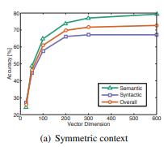
Model Analysis: Vector Length and Context Size
The graph below shows that the vector larger than 200 dimensions will be smoothing.
Can also refer to this paper about dimensionality of the word vector: https://arxiv.org/abs/1812.04224

Slide 24
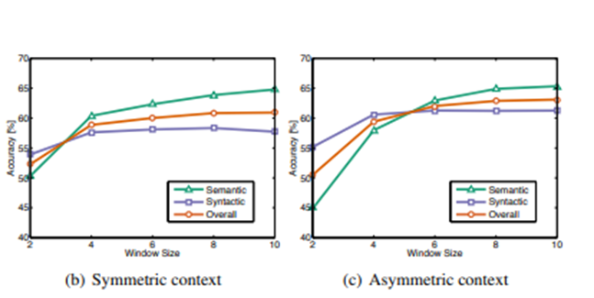
Model Analysis: Vector Length and Context Size
The graphs below demonstrate
Syntactic task performs better on small and asymmetric window
Semantic task performs better on larger window size
it is better to take global information into account on semantic task.

Slide 25
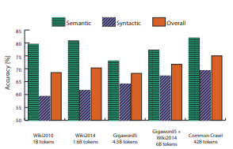
Model Analysis: Corpus Size
Accuracy
Larger corpus size yields higher accuracy on syntactic tasks
However: Semantic tasks don’t always follow this rule
Example
Accuracy of larger Giagaword corpus doesn’t have higher accuracy than smaller wiki corpus
Reason: Giagaword (news) don’t assimilate new knowlege

Slide 26
Glove Result: The Closet Word to the Word Frog
Source: https://nlp.stanford.edu/projects/glove/

Slide 27
Evaluation of Word Vector

Slide 28
Methods of Evaluation
So far, we don’t know how to evaluate word vector.
Two Methods to Evaluate Word Vector
Intrinsic Evaluation
Extrinsic Evaluation

Slide 29
Intrinsic Evaluation
Intrinsic Evaluation
Evaluate word vector on sub-system
Fast to compute
Help to understand sub-system
Need the correlation with the real task.
Reason to use Intrinsic Evaluation
costly to evaluate the word vector with the entire system e.g. QA system

Slide 30
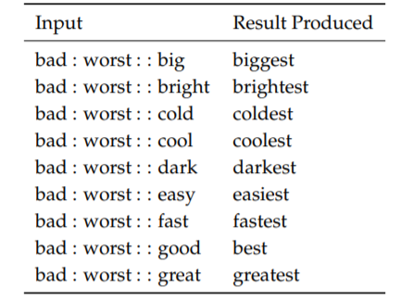
Intrinsic Evaluation: Word Analogy

Slide 31
Extrinsic Evaluation
Extrinsic evaluation
Evaluate word vector on real task
Slow to compute (opposite to intrinsic)
Hard to evaluate because it’s hard to know which system is problematic.

Slide 32
Introduction to Classification

Slide 33
Classification Setup and Notation
Training data usually consists of inputs and label. The sample is as follows.
$$\left\{X,Y\right\}$$
X is inputs such as word vector, sentences, documents.
Dimension d
Y is label that model needs to predict.
Class: sentiments, name entities, categories.
Words: Word Vector.

Slide 34
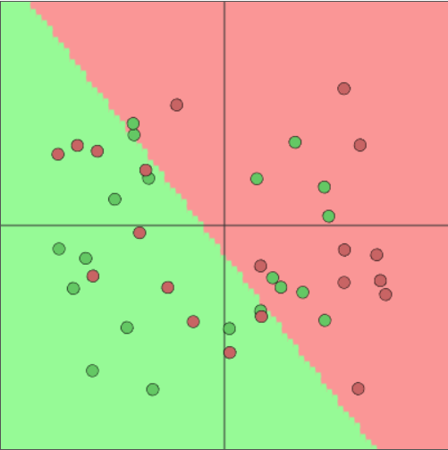
Classification Intuition
Data: $\left\{x_{i},y_{i}\right\}$
Suppose we have 2 dimensions word vectors and train the classifier with Softmax / Logistic Regression which is traditional ML approaches. The decision boundary will be as follows.
Source: https://cs.stanford.edu/people/karpathy/convnetjs/demo/classify2d.html
Linear Boundary

Slide 35
Detail of Softmax Function
Softmax Function: $p\left(y | x\right)=\frac{\exp\left(W_{y}x\right)}{\sum_{c=1}^{C}{{exp⁡(W}_{c}x)}}$
Take $y^{th}$ row of W and multiply it with x. Each row in W is corresponding to each category.
$W_{y}x=\sum_{i=1}^{d}{W_{yi}x_{i}}$ = fy
Calculate probability with Softmax function
$p\left(y | x\right)=\frac{\exp\left(fy\right)}{\sum_{c=1}^{C}{exp⁡(fc)}}$ , for c = 1, …., C

Slide 36
Difference between Softmax and Logistic Regression
They are basically the same.
However: The main difference between them is weight vector.
Number of weight vector for 2 classes
 | Number of Weight Vector
Softmax | 2
Logistic Regression | 1

Slide 37
Softmax and Cross-Entropy Loss
The main objective is to maximum probability of correct class y.
However: maximum log probability of correct class is the same as minimum negative log probability of correct class.
Thus: the formula is as follows.
$−\log\left(p\left(y | x\right)\right)=−log⁡\left(\frac{\exp\left(fy\right)}{\sum_{c=1}^{C}{exp⁡(fc)}}\right)$, for c = 1, …., C
Pytorch Note
Pytorch has nn.NLLLoss() function to combine with Log Softmax. Or you can use nn.CrossEntropyLoss directly.

Slide 38
What is cross-entropy loss?
Comes from Information Theory.
Suppose we have one-hot vector, [0,…,0,1]. Let P be the true probability and q be the predicted probability. The cross-entropy loss is as follows.
$H\left(p,q\right)=−\sum_{c=1}^{C}{p\left(c\right)\log{q(c)}}$
Since we adopt one-hot encoding, the only non-zero term is true class. Therefore, we get
$−\log\left(p\left(y | x\right)\right)=−log⁡\left(\frac{\exp\left(fy\right)}{\sum_{c=1}^{C}{exp⁡(fc)}}\right)$, for c = 1, …., C

Slide 39
Full Dataset Classification
The cross-entropy is revised as follows.
$J\left(θ\right)=\frac{1}{N}\sum_{i=1}^{N}{−\log\left(\frac{\exp{(f_{yi})}}{\sum_{c=1}^{C}{\exp{(f_{c})}}}\right)}$
$f_{y}=W_{y}x= \sum_{i=1}^{d}{W_{yi}x_{i}}$ will be
f = Wx
Matrix Notation

Slide 40
Conventional ML Optimization
W is the only term that optimization term, $θ,$includes.
Therefore: The decision boundary is updated only via W.
$θ=\left[\begin{matrix}\begin{matrix}W_{1} \\ ⋮\end{matrix} \\ W_{d}\end{matrix}\right]$
$∇_{θ}J\left(θ\right)=\left[\begin{matrix}\begin{matrix}∇W_{1} \\ ⋮\end{matrix} \\ ∇W_{d}\end{matrix}\right]$

Slide 41
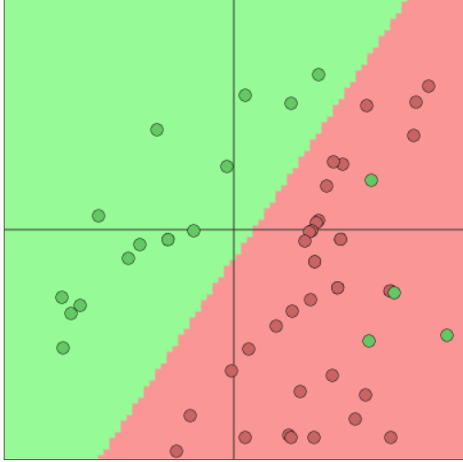
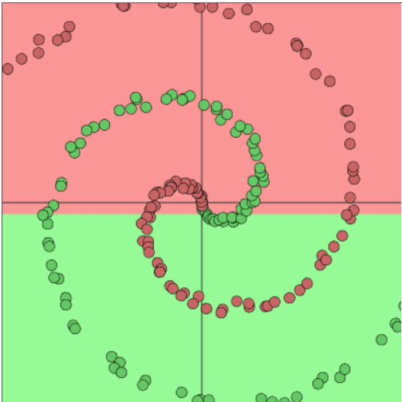
What if data becomes much more complex?
Source: https://cs.stanford.edu/people/karpathy/convnetjs/demo/classify2d.html
Clearly, complex model is required.

Slide 42
Neural Network

Slide 43
Classification in Deep Learning
Common NLP problem in deep learning learns both W and word vector x.
Thus: Optimization terms will be
${ ∇}_{θ}J\left(θ\right)=\left[\begin{matrix}\begin{matrix}∇W_{1} \\ ⋮\end{matrix} \\ \begin{aligned}∇W_{d} \\ ⋮ \\ ∇x_{good} \\ ∇x_{better}\end{aligned}\end{matrix}\right]$

Slide 44
Neural Network of Human Beings

Slide 45
Single Neuron of ANN

Slide 46
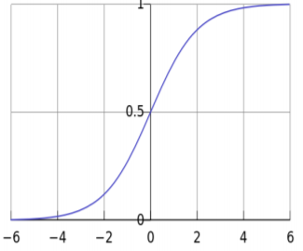
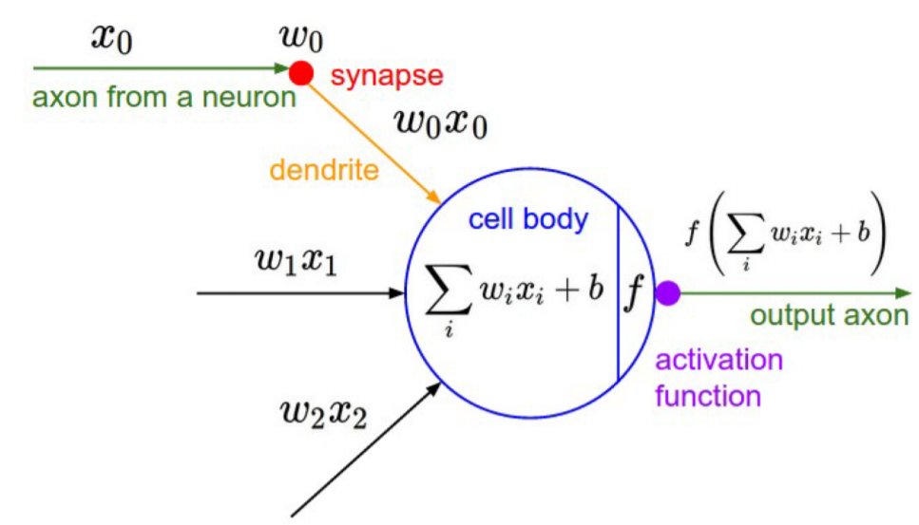
A neuron is equal to a binary logistic regression
Suppose activation function is equal to sigmoid.
$z=w^{T}x+b$
$f\left(z\right)=\frac{1}{1−\exp{(−z)}}$
Activation function is not limited to sigmoid.

Slide 47
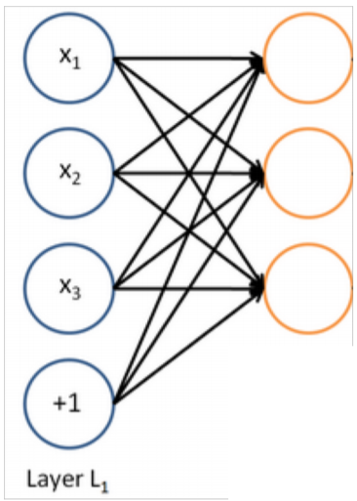
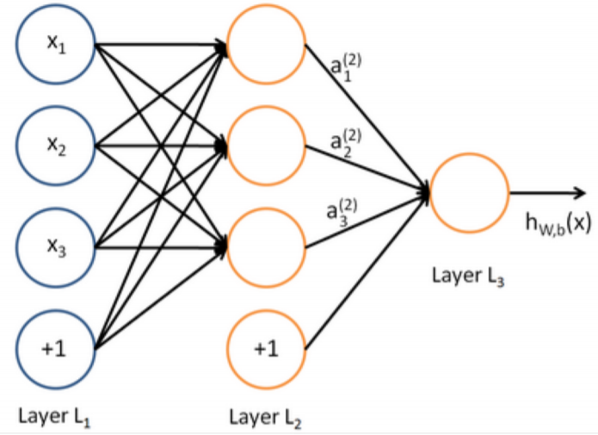
A neural network is equal to running many logistic regression simultaneously
Multi-layer Neural Network
Back-propagation determines the parameters in hidden layer to make a good decision.

Slide 48
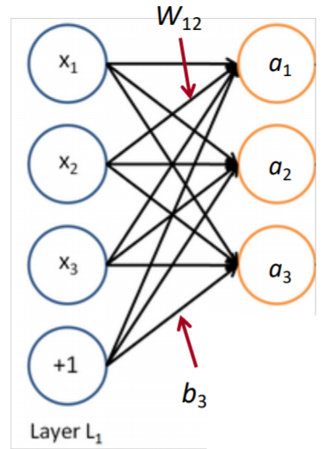
Matrix notation for a layer
$a_{1}=f(W_{11}x_{1}+W_{12}x_{2}$+$W_{13}x_{3}+b_{1}$)
…
Matrix Notation
z$=Wx+b$
a = f(z)
Activation function is element-wise
$f\left(\left[z_{1}{, z}_{2}{, z}_{3}\right]\right)=\left[{f(z}_{1}){, f(z}_{2}){, f(z}_{3})\right]$

Slide 49
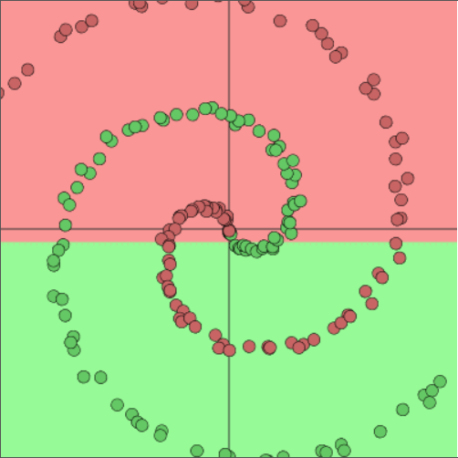
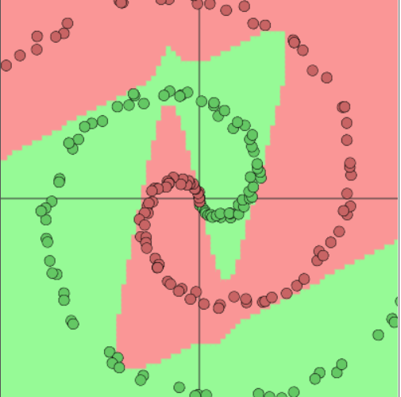
Why non-Linear?
Source: https://cs.stanford.edu/people/karpathy/convnetjs/demo/classify2d.html
Without non-linearity, it’s still linear transformation.

Slide 50
Name Entity Recognition

Slide 51
Name Entity Recognition (NER)
Google有限公司_{ORG}（英語_{LANGUAGE}：Google LLC_{ORG}；中文_{LANGUAGE}：谷歌_{ORG}[7][註 2]）是源自美國_{GPE}的跨國科技公司，為Alphabet Inc_{ORG}.的子公司，業務範圍涵蓋網際網路廣告、網際網路搜尋、雲端運算等領域，開發並提供大量基於網際網路的產品與服務[9_{CARDINAL}]，其主要利潤來自於AdWords_{ORG}等廣告服務[10_{CARDINAL}][11]。Google_{ORG}由在史丹佛大學_{ORG}攻讀理工博士的賴利·佩吉_{PERSON}和謝爾蓋·布林_{PERSON}共同建立，因此兩_{CARDINAL}人也被稱為「Google Guys」[12_{CARDINAL}][1_{CARDINAL}3][14_{CARDINAL}]。
https://zh.wikipedia.org/wiki/Google
Purposes
Tracking particular entities in documents
Answer of QA System
Slot-Filling

Slide 52
Named Entity Recognition on Word Sequences
Name Entity Recognition is a classification problem. Classifier will predicts the class that the word belongs to.
Chia-Yi B-person
Su I-person
United B-nation
State I-nation
Hewlett B-ORG
Packard I-ORG
Enterprise I-ORG
Say O
BIO-Encoding

Slide 53
Why NER hard?
Hard to know if something is an entity
未來學校的教學非常不同
Is “未來學校” the school name or merely future school?
Ambiguity of Entity Class & Dependence on Context
佳益是助教 佳益公司今年有賺錢
Hard to know the unknown class
Zig Ziglar ?
What ?
Actually Person

Slide 54
Binary Word Window Classification
Natural language is sometimes equivocal so we hardly classify single word.
Example of ambiguous words are as follows. They are auto-antonym.
Sanction means both “permit” and “punish”.
Seed means both “produce” and “remove”.
The meaning of the words are according to its context.

Slide 55
Window Classification
We classify a word in context instead.
Approach: Average the word vector and classify this average word vector.
However: This doesn’t work well because it might lose position information.
Resolution?

Slide 56
Window Classification: Softmax and Concatenation of Word Vector
Instead of classifying average vector, we classify the center word with concatenation of word vector surrounding it.
Suppose we have a sentence “NKUST in Taiwan has many departments.” and we want to classify Taiwan with window size 2. We also suppose that the dimension of word vector is 4.
$x_{\text{Taiwan}}={\left[x_{\text{NKUST}},{ x}_{\text{in}}, x_{\text{Taiwan}}, x_{\text{has}},x_{\text{many}}\right]}^{T}∈R^{5d}$, in this case, d is 4.This is also a column vector.
Softmax and cross-entropy are the same as before. In addition, the word vector is required to update by taking derivative.

Slide 57
Discussion on Word Vector

Slide 58
Derivative of Gradient wrt Words
$x_{window}= \left[x_{\text{NKUST}},{ x}_{\text{in}}, x_{\text{Taiwan}}, x_{\text{has}},x_{\text{many}}\right]$
Let $∇_{x}J={∇_{x}W}^{T}x_{window}= δ_{window}$
$δ_{window}=\left[\begin{aligned}∇x_{\text{NKUST}} \\ ∇x_{\text{in}} \\ ∇x_{\text{Taiwan}} \\ ∇x_{\text{has}} \\ ∇x_{\text{ma}ny}\end{aligned}\right]∈R^{5d}$
We connect only windows to the classifier instead of the whole word vector.
We will update one word vector each time.
This is called sparse update.
Updating word vector is basically good. but

Slide 59
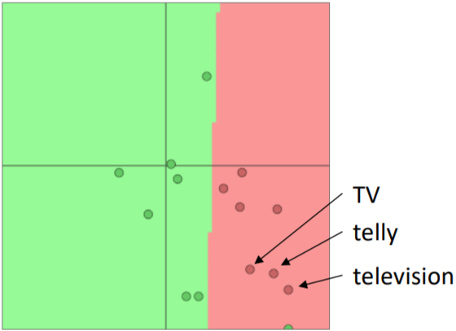
Pitfall while retraining word vector
Suppose movie review sentiment classifier is trained with a single word.
the words “TV” and “Telly” are in the training data.
the word television is in the test data
the pre-trained model is as follows

Slide 60
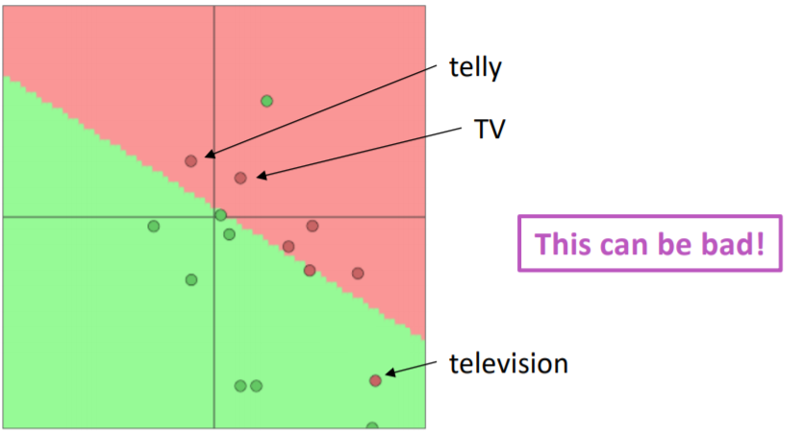
What happen when word vector is updated?
Answer
Since we only update the words that are in the training data, the model after updating is as follows.
Only Telly and TV are updated

Slide 61
Common Questions for Word Vector
Should I use available pre-trained word vector?
Almost always, yes
Word vector algorithm such as skip-gram is easy to train billions of words so it can even know the data not in the training data.
It’s ok to train our own word vector if we have 100s millions of words. Machine translation is one of examples that is not required to use pre-trained model.
Should I update the word vector?
It depends.
Just fix the word vector if the data is small i.e. thousands of words
It probably has a better result in large data if we update the word vector.

Slide 62
Reference
Manning et al., CS224n Natural Language Processing with Deep Learning, Stanford University
Pennington et al., GloVe: Global Vectors for Word Representation
Mundra et al., Stanford University : Lecture 2 Notes

