Slide 1
Recurrent Neural Networks and Language Models
Chia-Yi Su
Department of Electronic Engineering
National Kaohsiung University of Science and Technology

Slide 2
Course Outline
Basic Knowledge on Natural Language Processing
Applications of Natural Language Processing
Word Vector
Neural Network (Including Relative Math Derivation)
Dependency Parsing
Recurrent Neural Network, Variants of Recurrent Neural Network, and Language Model
Machine Translation
Contextual Representation
Dialog System (Including MultiModal Dialog System)

Slide 3
Today’s Agenda
Language Model
Unfolding Computational Graph
RNN Introduction
Back-Propagation and Loss Function
Length Determination and Algorithm Complexity
Teacher Forcing Network
Text Generation Example
Model Evaluation
RNN Examples

Slide 4
Language Model

Slide 5
Overview
Motivation of Recurrent Neural Network (RNN)
Language Model
Today will start from language model.

Slide 6
Language Model: Introduction
The prediction of next word called language model
台灣有很多 _____
And many words
美食
學校

Slide 7
Language Model: Formal Definition
Let’s say we have a sequence of word${ x}^{1}…x^{t},$and we need to compute the probability of $x^{t+1}$ which is next word.
$p\left({{ x}^{t+1}|{ x}^{t},…,x}^{1}\right)$
where ${ x}^{t+1}$comes from all sets of vocabularies.
The computation of the probability of next word is called language model.

Slide 8
Language Model
Language model can also assign probability to a piece of text.
Suppose we have a piece of text, ${ x}^{1}…x^{T}$, then our the probability of this text will be as follows
$p\left(x^{1},…,x^{T}\right)=p\left(x^{1}\right)∗p\left(x^{2}|x^{1}\right)∗…∗p\left(x^{T}|x^{T−1},…,x^{1}\right)$
$= \prod_{t=1}^{T}{p\left(x^{t}|x^{t−1},…,x^{1}\right)}$

Slide 9
Language model is everywhere and every day

Slide 10
N-gram Language Model
台灣有很多 _____
How to learn a language model?
N-gram (Pre-Deep Learning)
Will not explain on this lecture.

Slide 11
N-gram Language Model: Problems
以吃的方面，台灣有很多___
Sparsity (4-Grams)
$\frac{\text{C}\text{(}\text{有很多}\text{___}\text{)} }{C(\text{有很多})}$
Numerator: add smoothing term
Denominator: Back off
This problem gets worse when n is increased.
Storage
Needs to store all the counts

Slide 12
N-Gram Model in Practice: Reuters Corpus
Today the ___
Probability Distribution
company 0.153
bank 0.153
price 0.077
italian 0.039
emirate 0.039
Have a sparsity problem.
Source: https://nlpforhackers.io/language-models/

Slide 13
Tri-Gram Language Model: Text Generation
Today the ___
Probability Distribution
company 0.153
bank 0.153
price 0.077
italian 0.039
emirate 0.039

Slide 14
Tri-Gram Language Model: Text Generation
Today the price ___
Probability Distribution
of 0.308
for 0.050
it 0.046
to 0.046
is 0.031
…

Slide 15
Tri-Gram Language Model: Text Generation
today the price of gold per ton , while production of shoe lasts and shoe industry , the bank intervened just after it considered and rejected an imf demand to rebuild depleted european stocks , sept 30 end primary 76 cts a share .
Grammatical but Incoherent. Language model will become better if we increase n.
However: increasing n worsens sparsity problem

Slide 16
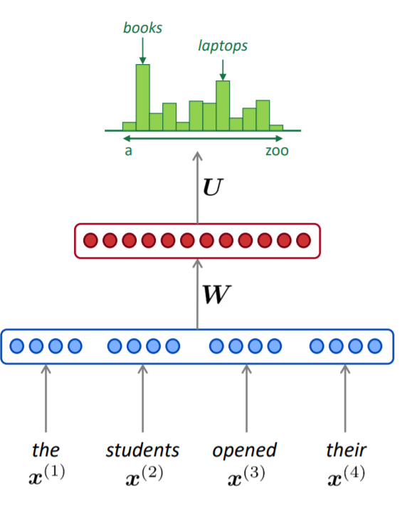
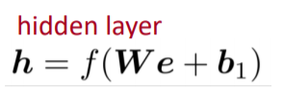
Neural Language Model: Fixed-Window
as the proctor started the clock the students opened their ___

Slide 17
Fixed-Window: Pros and Cons
Advantage
Solve all problems on N-gram LM
Disadvantage
Fixed-Window is too small
W enlarges when we enlarge window size
Window is never large enough
All inputs is multiplied by different W.
$\left[\begin{matrix}1 & 2 \\ 1 & 2\end{matrix}\right]$ $\left[\begin{matrix}1 \\ 2\end{matrix}\right]$
Clearly, a neural network to process any length of input is required.
w
e

Slide 18
Unfolding Computational Graph

Slide 19
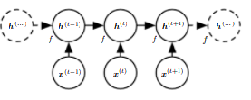
Unfolding Computational Graph
Recurrence Equation
$S^{(t)}=f\left(S^{(t−1)};θ\right)$
Non-Recurrence Equation (suppose t = 3)
$S^{(3)}=f\left(S^{(2)};θ\right)$
$=f\left(f\left(S^{\left(1\right)};θ\right);θ\right)$
Unfolded Graph

Slide 20
Advantages of Unfolded Process
No matter how long the sentence is, the model always has the same size.
Same transition function with same parameter can be applied to every time step.
Because of all of the factors above,
Model can generate a sequence whose length doesn’t appear in the training examples.

Slide 21
Comparison of Recurrent and Unrolled Graph
Recurrent Graph
Succinct
Unrolled Graph
Explicit
Help to illustrate the information forward and backward

Slide 22
RNN Introduction

Slide 23
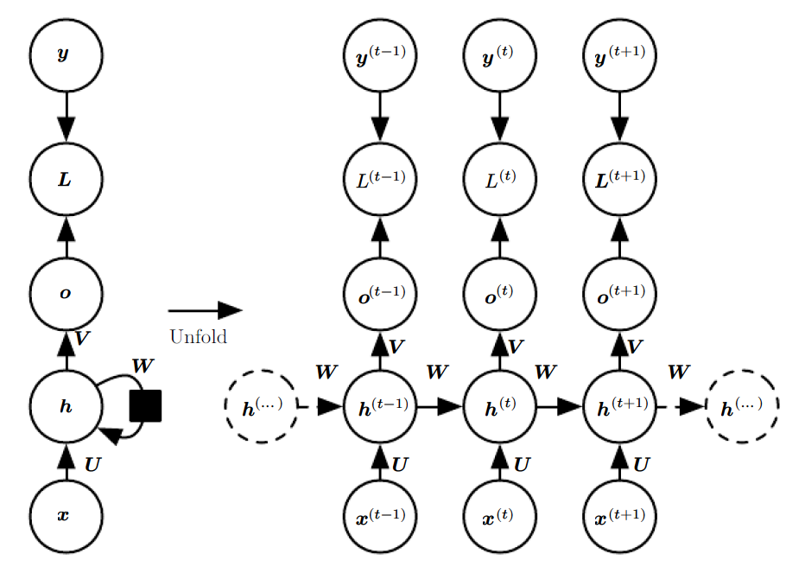
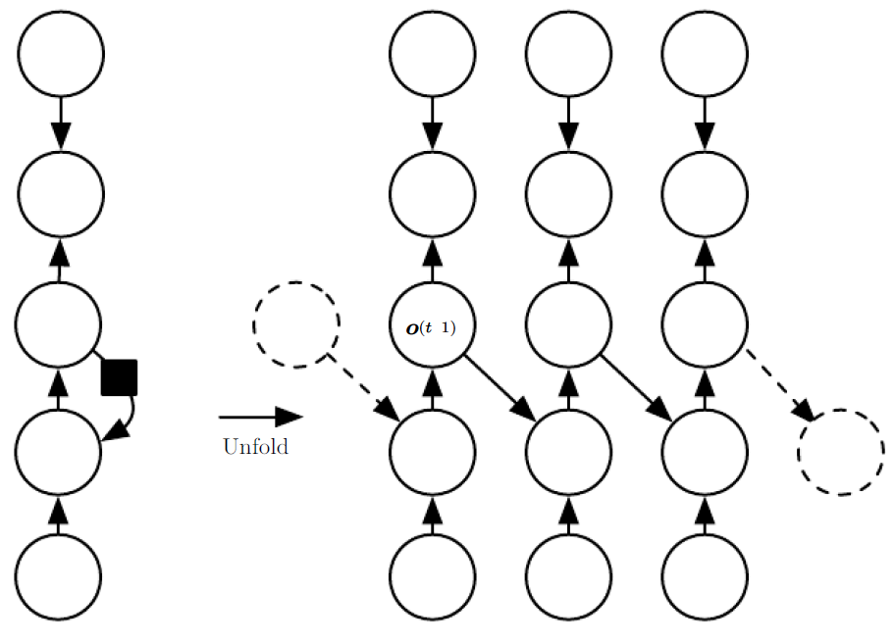
RNN Design Patterns

Slide 24
RNN Design Patterns

Slide 25
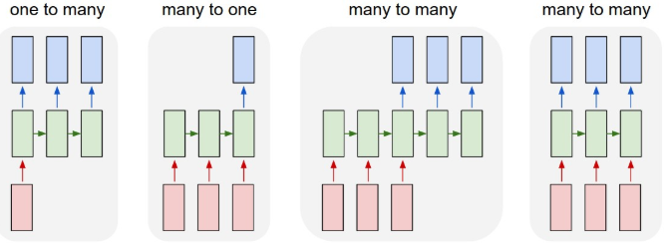
RNN Overview
(1) Image Captioning (2) Sentiment Analysis (3) Machine Translation (4) Video Classification
(1) (2) (3) (4)

Slide 26
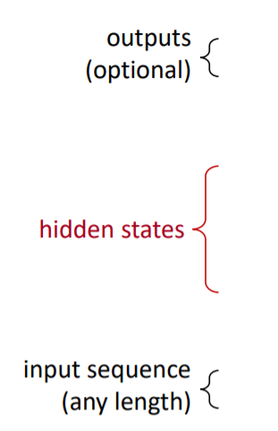
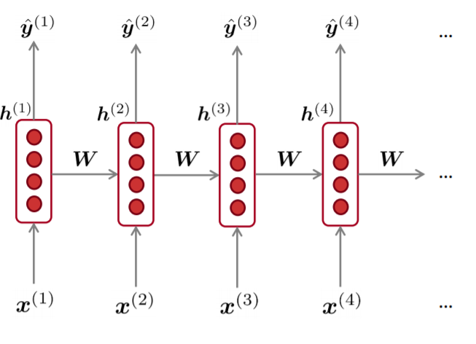
Recurrent Neural Network (RNN)
W is used repeatedly.
Hidden state is computed by using both previous state and input on that state.
Input sequence can be any
length.
Outputs are optional. We can
choose to output only few y or
all y.

Slide 27
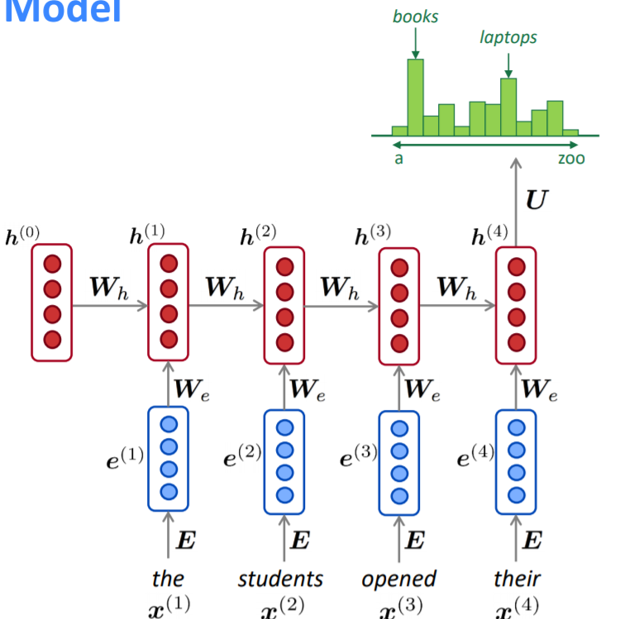
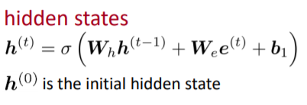
Detail of RNNLM

Slide 28
RNNLM: Pros and Cons
Advantages
Possible to process any length of inputs
Information from many steps back is used theoretically when we compute step t.
Increasing input doesn’t increase model size.
Inputs are processed symmetrically since weights are applied repeatedly.
Disadvantages
Computational Slowly
It’s hard to get the information from many steps back empirically.

Slide 29
RNNLM: Training
Feed the sequence of words into RNN; compute the output probability on each step t.
Loss Function
Average the overall loss for whole training set

Slide 30
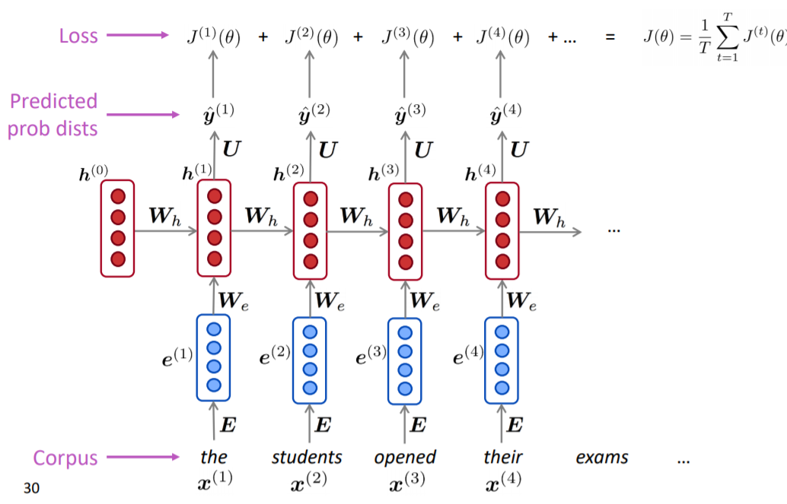
RNNLM: Training

Slide 31
RNNLM: Training
The computation of gradients over entire corpus is very expensive.
Therefore: We compute only a batch sentences or a batch documents one time and repeat according to SGD.

Slide 32
Back-Propagation and Loss Function

Slide 33
RNN: Backpropagation
$\frac{∂J^{(t)}}{∂W_{h}}=\sum_{i=1}^{t}{\frac{∂J^{(t)}}{∂W_{h}}|_{(i)}}$
This is called “backpropagation through time”
How to Calculate?

Slide 34
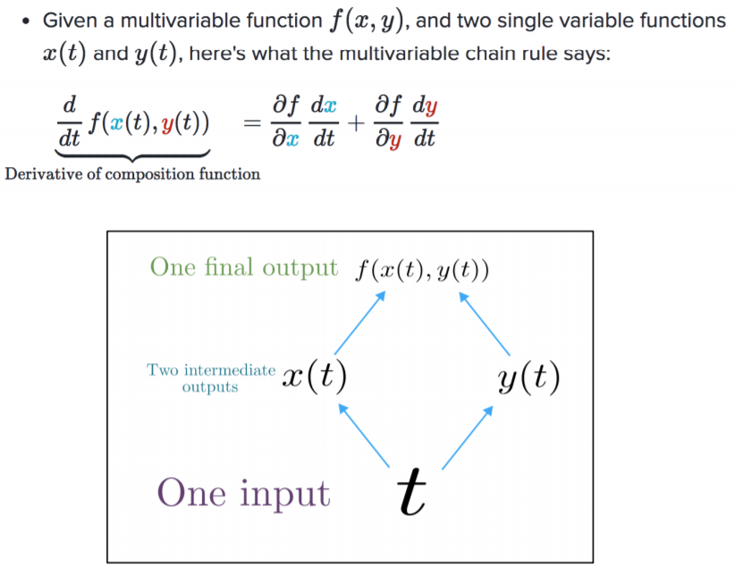
Backpropagation: Multivariable Chain Rule
Source: https://web.stanford.edu/class/archive/cs/cs224n/cs224n.1194/slides/cs224n-2019-lecture06-rnnlm.pdf

Slide 35
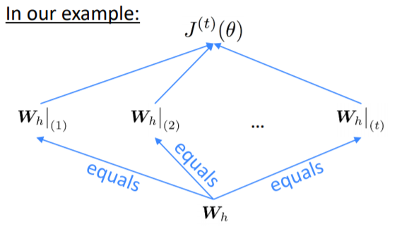
Backpropagation: RNN
$\frac{∂J^{(t)}}{W_{h}}=\sum_{i=1}^{t}{\frac{∂J^{(t)}}{∂W_{h}}}|_{i}∗\frac{∂W_{h}|_{i}}{∂W_{h}}$
$\frac{dx}{dx}=?$
Timestep is from t to 1.
Source: https://web.stanford.edu/class/archive/cs/cs224n/cs224n.1194/slides/cs224n-2019-lecture06-rnnlm.pdf

Slide 36
RNN: Loss Function
Loss function is chosen based on the task.
if task is to interpret the output of RNN as probability distribution,
Cross-Entropy loss will be employed.
If task is to predict the future word,
The goal will be maximum log-likelihood or minimum negative log-likelihood

Slide 37
Length Determination and Algorithm Complexity

Slide 38
RNN: How to determine the length of sequence
Add special symbol when the output is a symbol from vocabulary (Schmidhuer, 2012)
Add extra Bernoulli model to decide whether our model should continue or halt (better and more general)
Add extra output to predict the length of the sequence. The model is formularized as follows (Goodfellow, 2014d)
$p\left(x^{(1)},…,x^{(τ)}\right)=p\left(τ\right) p\left(x^{(1)},…,x^{\left(τ\right)}|τ\right)$
Law of Total Probability

Slide 39
RNN: Complexity
Forward Propagation Runtime (cannot be parallelized)
$O\left(τ\right)$
Forward Propagation Memory Cost
$O\left(τ\right)$
Backward Propagation Runtime
$O\left(τ\right)$
Parameter Complexity
O(1)

Slide 40
Teacher Forcing Network

Slide 41
Teacher Forcing Network: Motivation
The network in the figure is
Less powerful
Cannot simulate Turing machine
Can be parallelized

Slide 42
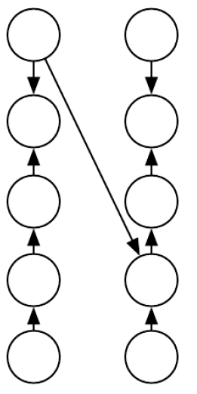
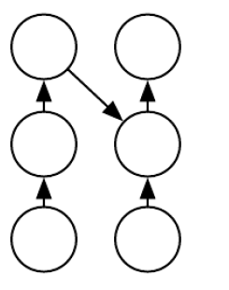
Teacher Forcing Network: Introduction
Teacher Forcing: input at time t + 1 receives the ground truth output at time t.
Goal: Maximum Likelihood Criterion
Train
Test

Slide 43
Maximum Likelihood Criterion: Example
Suppose t = 2, the likelihood criterion is as follows.
$$\log{p\left(y^{(1)}y^{(2)}|x^{\left(1\right)},x^{(2)}\right)}$$
= $\log{p\left(y^{(2)}|y^{\left(1\right)},x^{\left(1\right)},x^{(2)}\right)}+$ $\log{p\left(y^{(1)}|x^{\left(1\right)},x^{(2)}\right)}$

Slide 44
Teacher Forcing Network: Disadvantages & Solution
Disadvantage
Limitation arises when network is close-loop (e.g. generation model)
Solutions
Train both teacher-forced (ground-truth) network and free-running (predicted) network
Randomly choose generated value or actual value (Bengio et al., 2015b)

Slide 45
Text Generation Example

Slide 46
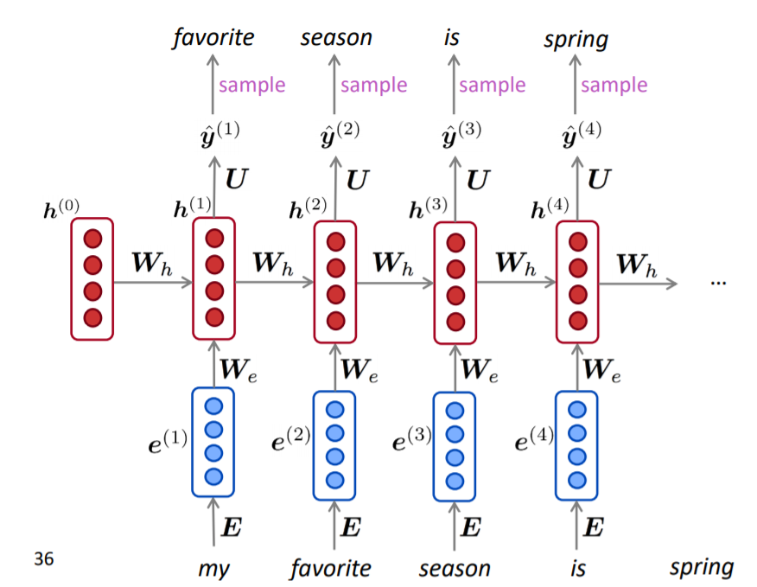
RNNLM: Text Generation
RNNLM can be used to generate text which is similar to n-gram model.
The output is the input of next step.

Slide 47
RNNLM trained on Obama Speech
Fluent but difficult to read
Source: https://medium.com/@samim/obama-rnn-machine-generated-political-speeches-c8abd18a2ea0

Slide 48
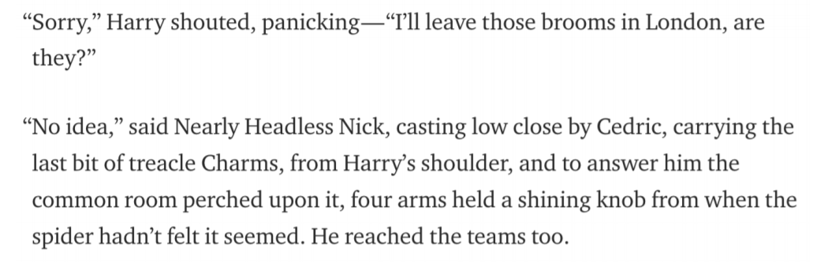
RNNLM trained on Harry Potter
Have the characteristic’s name but still difficult to read. It has run-on sentences.
Source: https://medium.com/deep-writing/harry-potter-written-by-artificial-intelligence-8a9431803da6

Slide 49
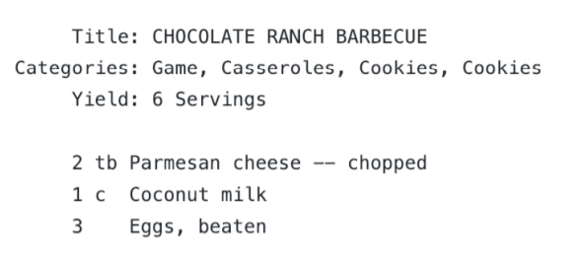
RNNLM trained on Recipes
This is quite challenging.
Still fluent but nonsensical
Source: https://gist.github.com/nylki/1efbaa36635956d35bcc

Slide 50
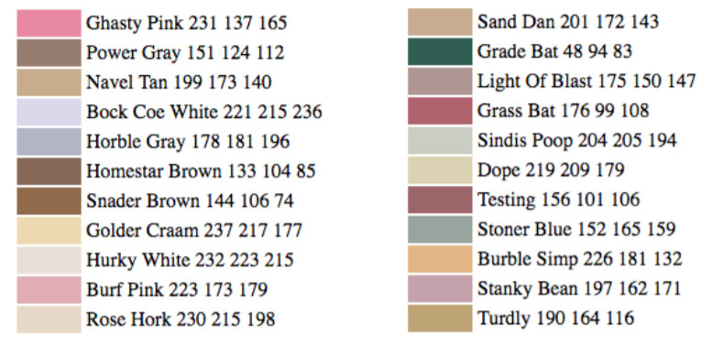
RNNLM trained on Paint Color Name
character lever RNNLM
Trained by using RGB
https://aiweirdness.com/post/160776374467/new-paint-colors-invented-by-neural-network

Slide 51
RNNLM: Warning
The training examples may be hand-selected or edited by human.
Therefore: The sentences generated by language model may be fake.

Slide 52
Model Evaluation

Slide 53
Language Model Evaluation
Perplexity is the evaluation metric for language model.
$perplexity= \prod_{t=1}^{T}{{\left(\frac{1}{P\left(x^{(t+1)}|x^{t}…x^{1}\right)}\right)}^{1/T}}$
$=exp\left(\frac{1}{T}\sum_{t=1}^{T}{−\log{{\hat{y}}_{x_{t+1}}^{(t)}}}\right)=exp⁡(J\left(θ\right))$
Lower perplexity is better.

Slide 54
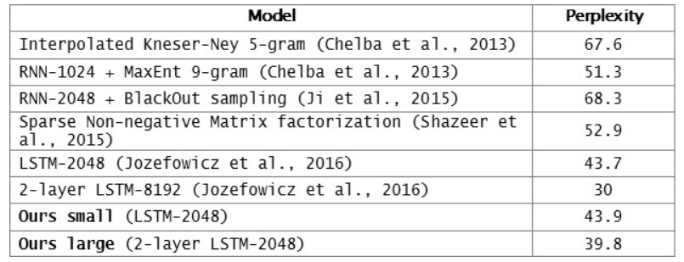
RNNs have greatly improved perplexity
https://research.fb.com/building-an-efficient-neural-language-model-over-a-billion-words/

Slide 55
RNN Examples

Slide 56
Why is Language Model important?
Language Model is a benchmark task so it can help us understand how well the computer understands human language.
Language Model is involved in many NLP tasks. E.g.
Predictive typing
Speech recognition
Handwriting recognition
Spelling/grammar correction
Authorship identification
Machine translation
Summarization
Dialogue

Slide 57
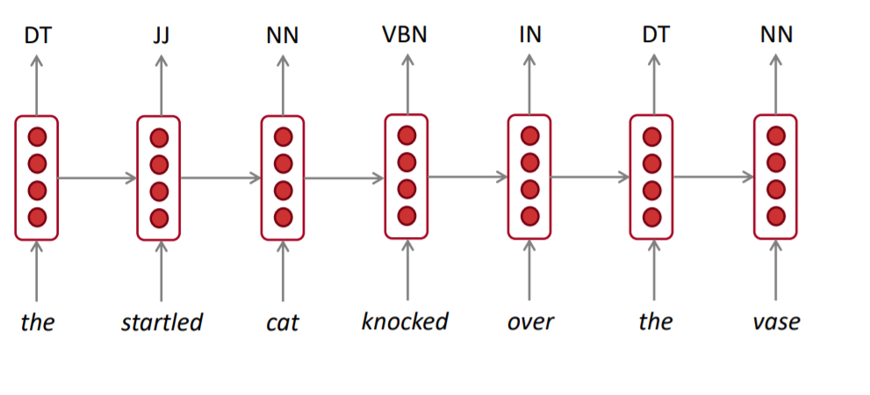
RNN for Tagging
E.g. Part-of-Speech, Name Entity Recognition

Slide 58
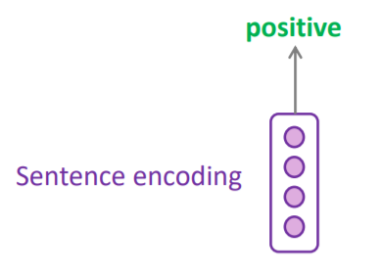
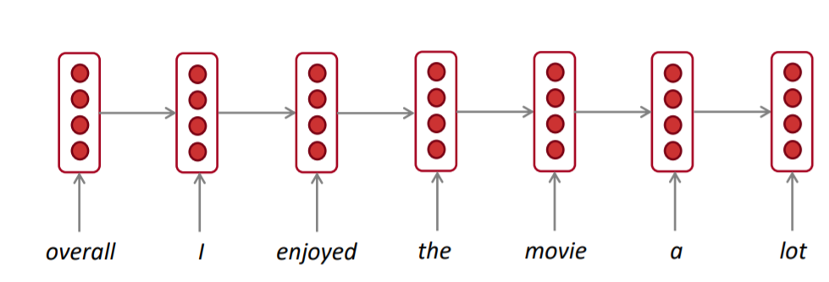
RNN for Sentence Classification
e.g. Sentiment Classification
How to choose encoding?
Final Hidden State
Element-wise max or mean

Slide 59
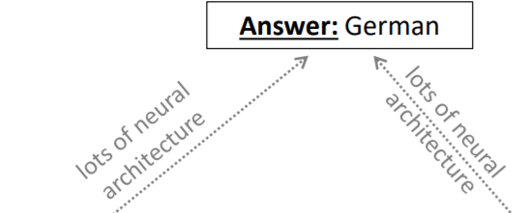
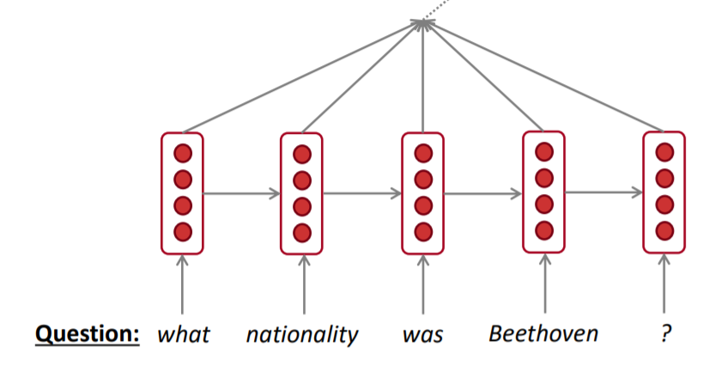
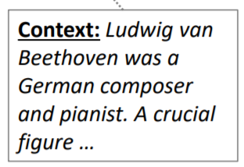
RNN for Encoder
QA System, Machine Translation etc.

Slide 60
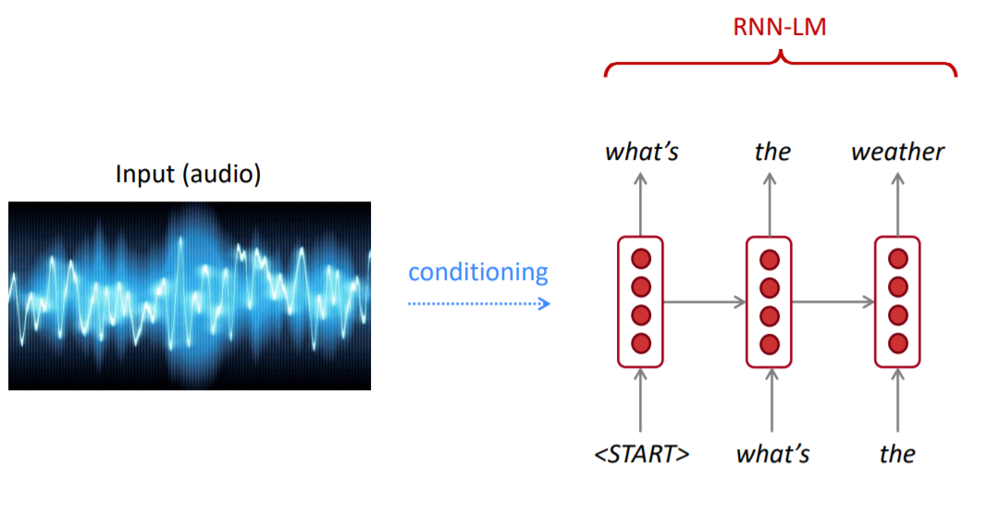
RNN for Text Generation
Speech Recognition, Machine Translation etc.

Slide 61
Image Captioning
The task of describing image by using natural language.

Slide 62
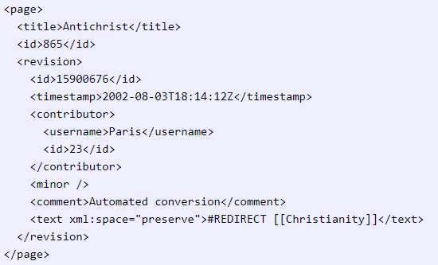
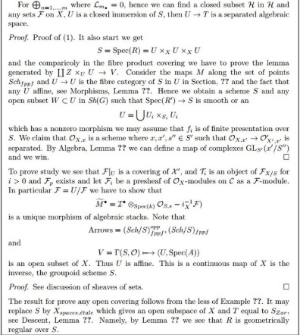
Fun Examples

Slide 63
References
Manning et al., CS224n Natural Language Processing with Deep Learning, Stanford University
Goodfellow et al., Deep Learning Books, Online Version
Karpathy and Li, Deep Visual-Semantic Alignments for Generating Image Descriptions.
The Unreasonable Effectiveness of Recurrent Neural Networks

