Slide 1
Machine Translation, Seq2Seq, Attention, and Transformer
Chia-Yi Su
Department of Electronic Engineering
National Kaohsiung University of Science and Technology

Slide 2
Course Outline
Basic Knowledge on Natural Language Processing
Applications of Natural Language Processing
Word Vector
Neural Network (Including Relative Math Derivation)
Dependency Parsing
Recurrent Neural Network, Variants of Recurrent Neural Network, and Language Model
Machine Translation
Contextual Representation
Dialog System (Including MultiModal Dialog System)

Slide 3
Today’s Agenda
Introduction to Machine Translation
Neural Machine Translation (NMT)
Attention
Transfer Learning
Transformer
Attention Is All You Need
BERT: Pre-training of Deep Bidirectional Transformers for Language Understanding
BART: Denoising Sequence-to-Sequence Pre-training for Natural Language Generation, Translation, and Comprehension

Slide 4
Introduction to Machine Translation

Slide 5
Machine Translation
Machine Translation (MT): the translation of a sentence x from one language to a sentence y in another language
x :我就讀高雄科技大學。
y : I study at NKUST.

Slide 6
Neural Machine Translation (NMT)

Slide 7
Neural Machine Translation (NMT)
Neural Machine Translation allows us to do machine translation with only a single neural network.
The neural network architecture is called sequence to sequence model which two RNNs are involved.

Slide 8
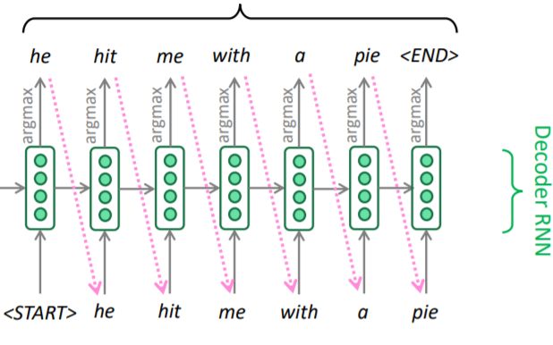
NMT : Sequence-to-Sequence Model
This is the test time behavior.

Slide 9
Seq2seq is versatile!!
Seq2seq is used not only in MT but other applications .
The tasks that seq2seq may be useful are as followings.
Summarization ( long text -> short text)
Dialogue (previous utterance -> next utterance)
Parsing (input text -> output parse as sequence)

Slide 10
NMT: Sequence-to-Sequence Model
Seq2seq is an example of conditional language model.
Language model: next words of target sentence y are predicted.
Conditional: predictions are conditioned on source sentence
NMT directly calculates $p\left(y|x\right)$:
$p\left(y|x\right)=p\left(y_{1}|x\right)p\left(y_{2}|y_{1},x\right)…p\left(y_{T}|y_{1}…y_{T−1},x\right)$
Question: How to train a NMT model?
Answer: Get a big parallel corpus…

Slide 11
NMT: Training Steps
Seq2seq is optimized as a single system.
Backpropagation operates end-to-end

Slide 12
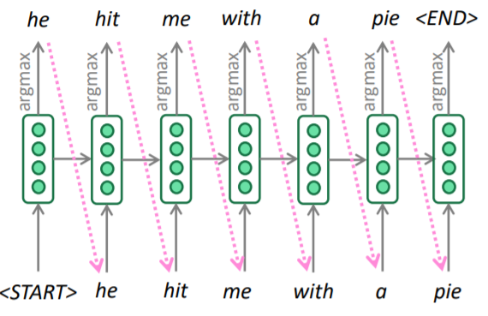
Greedy Decoding
For now, our decoder generates the target sentence by taking argmax on each step of decoder.
This method is called greedy decoding.

Slide 13
Greedy Decoding: Problems
No way to undo
Input: 我就讀高雄科技大學。
I
I study
I study and (an error occurs)
How to fix?
Beam Search

Slide 14
Exhaustive Search Decoding
Our goal is to find a translation y which maximizes the following probability.
$p\left(y|x\right)=p\left(y_{1}|x\right)p\left(y_{2}|y_{1},x\right)…p\left(y_{T}|y_{1}…y_{T−1},x\right)$
We could try computing all possible sequence y
This means we try to search $V^{T}$possible partial translation
O($V^{T}$) is extremely expensive computation.

Slide 15
Beam Search Decoding
On each steps of decoder, only k most probable partial translations are tracked which we called hypothesis.
k is the beam size
It’s around 5 to 10 in practice.
A score of hypothesis $y_{1},…,y_{t}$ is its log probability
Scores($y_{1},…,y_{t})=log⁡ P_{LM}(y_{1},…,y_{t}\left|x\right)=\sum_{i=1}^{t}{log⁡ P_{LM}(y_{i}\left|y_{1},…,y_{i−1},x\right)}$
Scores are all negative, and higher score is better.
We search for high score hypothesis and track top k on each steps.
It does not guarantee to find optimal solution.
However: it’s much more efficient.

Slide 16
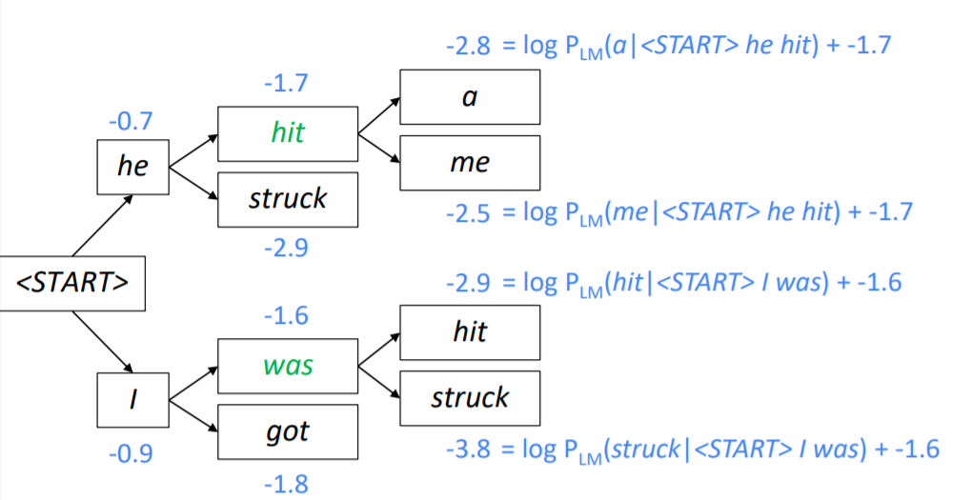
Beam Search Decoding: Example
Beam size =2

Slide 17
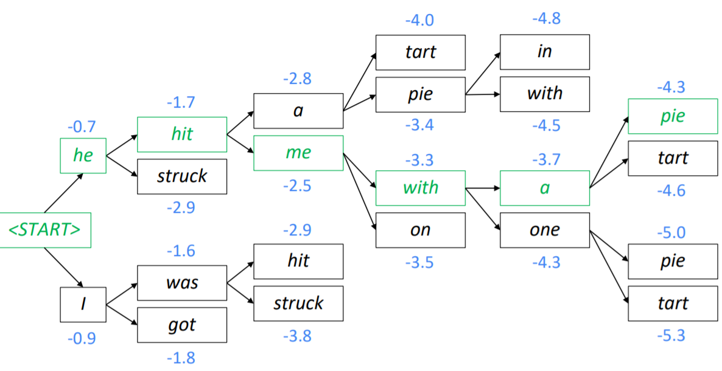
Beam Search Decoding: Example
Beam size =2

Slide 18
Beam Search Decoding: Stopping Criterion
Model is usually decoded until it produces a <END> token in greedy decoding.
E.g. <START> I study at NKUST <END>
Different hypothesis may produce <END> tokens on different timestep in beam search decoding.
When the hypothesis produces <END>, that hypothesis is complete.
Place it aside, and continue exploding different hypothesis.
The beam search is continued until,
We reach timestep T, where T is pre-defined.
We have at least n completed hypothesis, where n is pre-defined as well.

Slide 19
Beam Search Decoding: Wrap up
We have a list of completed hypotheses.
How to select top one with highest score?
Each hypothesis $y_{1},…,y_{t}$ on our list has a score
$$\text{Scores}\text{(}y_{1},…,y_{t})=log⁡ P_{LM}(y_{1},…,y_{t}\left|x\right)=\sum_{i=1}^{t}{log⁡ P_{LM}(y_{i}\left|y_{1},…,y_{i−1},x\right)}$$
Problem: Longer hypothesis has lower scores
Solution: Normalization with length
$$\frac{1}{t}\sum_{i=1}^{t}{log⁡ P_{LM}(y_{i}\left|y_{1},…,y_{i−1},x\right)}$$

Slide 20
NMT: Advantages
Advantages of NMT while comparing to SMT
Better performance
More fluent
Better use of context
Better use of phrase similarities
It’s optimized as a single neural network which is also called end-to-end.
Much less human engineering effort is required.
No feature engineering
Same method for all language pairs

Slide 21
NMT: Disadvantages
Disadvantages of NMT while comparing to SMT
Less interpretable
Hard to debug
Difficult to control
Can’t easily specifies rules or guidelines for translation
Safety concerns

Slide 22
How to evaluate Machine Translation?
Human Evaluation
Evaluation against Another Tasks
BLEU (Papineni et al., 2002)

Slide 23
Evaluation against Another Tasks
Idea: if the predictions are able to solve some challenge tasks, then the model must encode the relevant information in these predictions.
E.g. translation system -> QA system
If QA system performs well, it means the inputs have the relevant information or pattern for meeting the demands of task.

Slide 24
Is Machine Translation solved?
Definitely Not.
Many difficulties still remain
Out-of-Vocabuary words
Domain mismatch between train and test data
Maintaining context over longer text
Low-resources language pairs

Slide 25
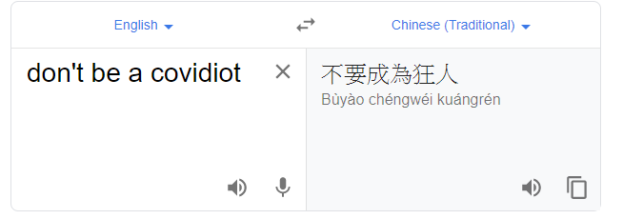
Is Machine Translation solved?
Nope
Out-of-Vocabulary

Slide 26
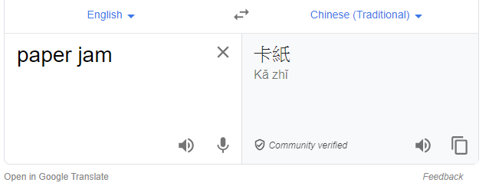
Is Machine Translation solved?

Slide 27
NMT research continues
NMT is a flagship task for NLP deep learning.
NMT leads to many of the recent innovations of NLP deep learning.
2019 : NMT research continues to thrive
There are many improvements to the seq2seq NMT systems
However : one integral improvement is called
Attention

Slide 28
Seq2Seq: the bottleneck problem

Slide 29
Attention

Slide 30
Attention
Attention provides a solution to the bottleneck problem.
Idea: Decoder is directly connected to the encoder and focuses on the particular part of source sequence.

Slide 31
Seq2Seq with Attention

Slide 32
Seq2Seq with Attention

Slide 33
Seq2Seq with Attention

Slide 34
Attention: in Equations
We have encoder hidden states $h_{1},…,h_{N}∈ℝ^{h}$
We have decoder hidden state, $s_{t}∈ℝ^{h}$, at time t.
We get the attention scores $e^{t}$ for this step:
$$e^{t}=\left[S_{t}^{T}h_{1},…,{S_{t}^{T}h}_{N}\right]∈ℝ^{N}$$
Softmax is applied to get the attention distribution $∝^{t}$ for this step.
$$∝^{t}=softmax\left(e^{t}\right)∈ℝ^{N}$$
Attention output, $a_{t},$ is acquired by using $∝^{t}$ to calculate the weighted sum.
$$a_{t}=\sum_{i=1}^{N}{∝_{i}^{t}h_{i}∈ℝ^{h}}$$
Finally, attention output is acquired by concatenating attention output $a_{t}$with hidden state $s_{t}$.
$$\left[a_{t},s_{t}\right]∈ℝ^{2h}$$

Slide 35
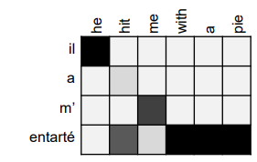
Attention is great
Attention
Improves NMT performance significantly.
Solves the bottleneck problems
Helps to deal with vanishing gradient problems
Provides interpretability
We can see the focus of decoder by inspecting the attention distribution
The network also leans the alignment by itself.

Slide 36
Attention: General Technique and Definition
Attention can be used in wide-range of tasks and models not only seq2seq and machine translation.
More General Definition
Given a set of vector values, and a vector query, attention is an approach to compute the weighted sum of the values based on the query.
We sometimes say that query attends to the values.
E.g. in seq2seq + attention model, each decoder hidden states (query) attends to all the encoder hidden state (values)

Slide 37
Attention: Variants
Suppose we have some values $h_{1},…,h_{N}$ $∈ℝ^{d_{1}}$ and query s $∈ℝ^{d_{2}}$
Attention always includes:
Computing attention scores e$ε ℝ^{N}$
Taking Softmax to acquire the attention distribution $∝$
$$∝ =softmax\left(e\right)∈ℝ^{N}$$
Using attention distribution to get the weighted sum
$$a=\sum_{i=1}^{N}{∝_{i}h_{i}∈ℝ^{h}}$$
Obtain the attention output a
There are multiple ways to do this

Slide 38
Attention: Variants
Ways to compute the attention scores
Dot-Product Attention: $e_{i}=s^{T}h_{i}ε ℝ$
Assume the dimensions are the same.
Multiplicative Attention: $e_{i}=s^{T}Wh_{i}ε ℝ$
Where W $ε { ℝ}^{d_{2}∗d_{1}}$ which is a weight matrix.
Additive Attention: $e_{i}=v^{T}tanh(W_{1}h_{i}+W_{2}s)ε ℝ$
Where $W_{1} ε { ℝ}^{d_{3}∗d_{1}}$ , $W_{2} ε { ℝ}^{d_{3}∗d_{2}}$ are weight matrices, and v $ε ℝ^{d_{3}}$ is a weight vector
$d_{3},$ which is an attention dimensionality, is a hyperparameter

Slide 39
Transfer Learning

Slide 40
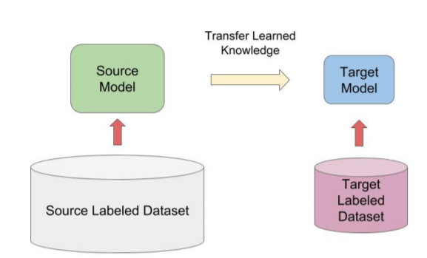
ULMfit: Transfer Learning Model
Howard and Ruder (2018)

Slide 41
ULMfit: Model Architecture
Learn a general LM
Fine-tune for specific task
Fine-tune for text classification

Slide 42
ULMfit Performance: Text Classifier Error Rate

Slide 43
ULMfit: Transfer Learning

Slide 44
Transformer

Slide 45
Let’s scale up!!

Slide 46
Transformer Models

Slide 47
Attention Is All You Need
Vaswani et al., NIPS, 2017.

Slide 48
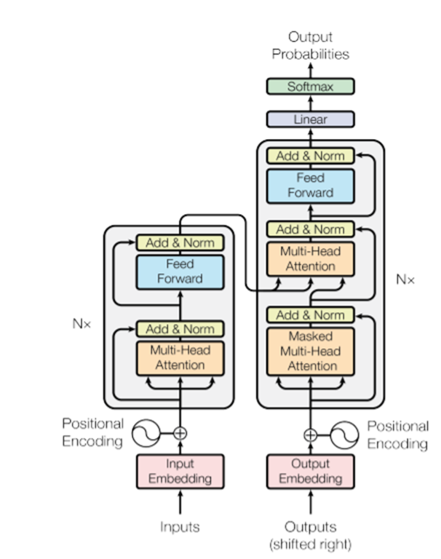
Introduction
Non-Recurrent sequence-to-sequence
encoder-to-decoder model.
Task : machine translation with parallel corpus
Predict each translated word
Loss Function
Cross-entropy loss on top of the softmax classifier

Slide 49
Dot-Product Attention
Inputs: a query q, and a set of key-value (k-v) pairs to an output, where
q, k, and v are vector.
Output is a weighted sum of values, where
Weight is computed by inner product of query and corresponding key
Dimension of queries and key are the same which are $d_{k}$
Dimension of values are $d_{v}$
$$A\left(q, K,V\right)=\sum_{i}{\frac{e^{qk_{i}^{}}}{\sum_{j}{e^{qk_{j}}}}v_{i}}$$

Slide 50
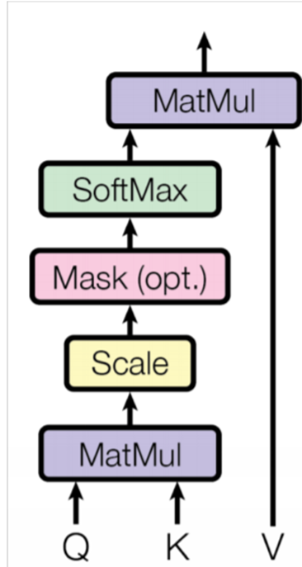
Scaled Dot-Product Attention
Problem: As $d_{k}$ gets large, the variance of $q^{T}k$increases -> some values inside Softmax increases -> Softmax becomes very peaked -> As a result, gradient becomes smaller
Solution : Scaled by 1 /$\sqrt{d_{k}}$ key vector
$$A\left(Q,K,V\right)=softmax\left(\frac{Q^{T}K}{\sqrt{d_{k}}}\right)V$$

Slide 51
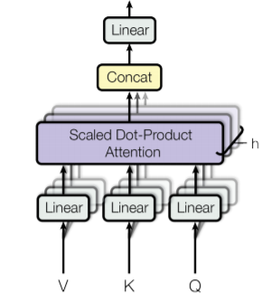
Multi-head attention
Problems with simple attention:
Only one way to catch the information between words
Solution: Multi-head attention
Feed Q, K and V into linear projection layer
Apply attention
Concatenate output
Pipe through linear layer

Slide 52
Add and Norm Block
Add and Norm block is used to normalize the data in each layer.
The combination of residual connection and layer normalization.
What if we do not normalize our data?
The convergence of neural network will be slow.
Prone to have overfitting problems
The formula of layer normalization is as follows:

Slide 53
Feed-Forward Network
The formula of feed-forward network is as follows

Slide 54
Positional Encoding
Since transformer do not have the sequential information, transformer employs positional encoding to acquire the sequential information.
The formula is as follows:

Slide 55
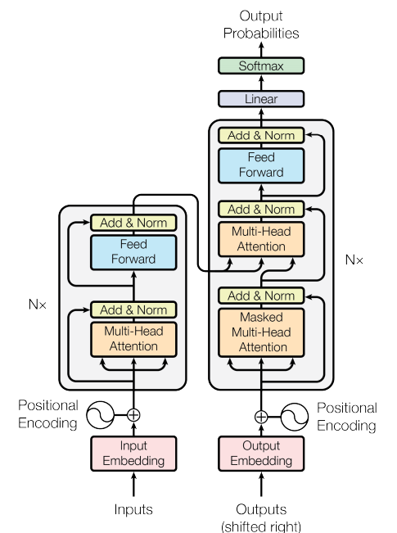
Transformer: Complete Encoder and Decoder
Blocks are repeated.
Encoder: 6 layers
Decoder: 6 layers

Slide 56
BERT: Pre-training of Deep Bidirectional Transformers for Language Understanding
Devlin et al., ACL, 2019.

Slide 57
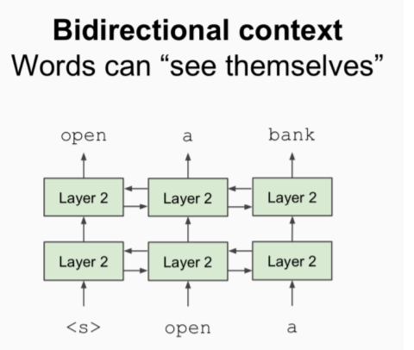
BERT: Motivation
Language model only uses unidirectional context
But: Language understanding is bidirectional
Why language model is unidirectional?
We need to use previous word to generate probability distribution.
Words can see themselves in bidirectional encoder.

Slide 58
BERT: Solution to the Problem
Mask out k% of the input words, and predict the masked words, where
k is always equal to 15.
student
He is a [Mask].
We need to find the trade-off. If mask is too
Little: Too expensive to train
Much: Not enough information.

Slide 59
BERT: Model Comparison

Slide 60
BERT Complication: Next Sentence Prediction
Learn the relationship and predict whether sentence B is next sentence of A.

Slide 61
BERT: Sentence Pair Encoding

Slide 62
BERT: Model Architecture and Training
Model Architecture
Transformer Encoder
Single Multiplication => Can be prallalized
Training
Train on Wiki + BookCorpus
Train 2 Model Size
BERT-Base: 12-layer, 768-hidden, 12-head
BERT-Large: 24-layer, 1024-hidden, 16-head
Trained on 4x4 or 8x8 TPU slice for 4 days

Slide 63
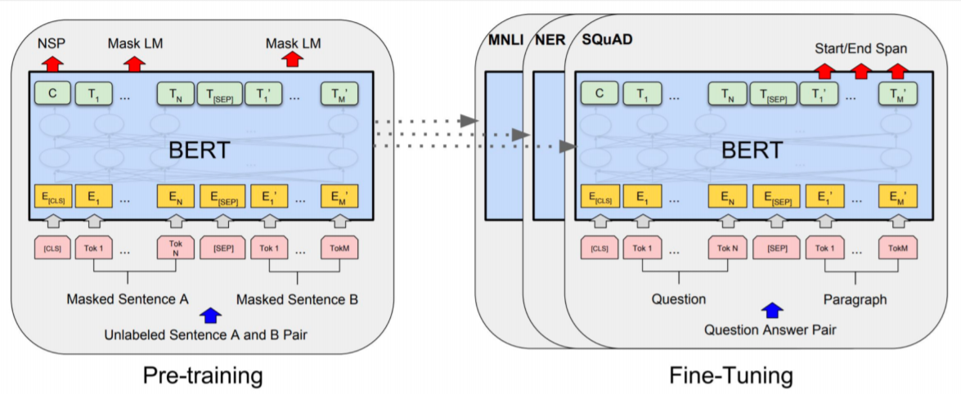
BERT: Model Fine-Tune
Pre-train the model for mask task and fine tune it for specific task.

Slide 64
BERT: Results on GLUE Tasks
GLUE tasks are the task of Natural Language Inference

Slide 65
NER Results

Slide 66
BERT: Results on SQuAD 1.1

Slide 67
SQuAD 2.0 leaderboard, 2019-02-07

Slide 68
BART: Denoising Sequence-to-Sequence Pre-training for Natural Language Generation, Translation, and Comprehension
Lewis et al., ACL, 2020.

Slide 69
Model Architecture

Slide 70
Pre-Training BART
Token Masking: The same as BERT (Devlin et al., 2019).
Token Deletion: Randomly delete the tokens from inputs.
Text Infilling: Sampling the text spans from inputs and replacing with [MASK]. The length of text spans is drawn from Poisson distribution.
Sentence Permutation: Randomly shuffle the sentences.
Document Rotation: Randomly choose the token and rotate the document so that it begins with that token.

Slide 71
Comparison between BERT and BART

Slide 72
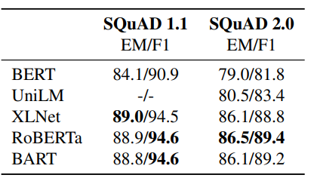
Training Results of Discriminative Tasks
GLUE Tasks
SQuAD

Slide 73
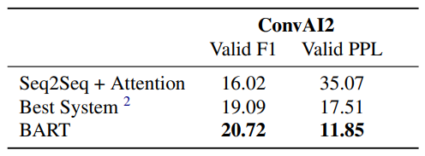
Training Results of Generation Tasks
Summarization Tasks
Conversational Response Generation

Slide 74
References
Manning et al., CS224n Natural Language Processing with Deep Learning, Stanford University

