Slide 1
Neural Network and Backpropagation
Chia-Yi Su
Department of Electronic Engineering
National Kaohsiung University of Science and Technology

Slide 2
Course Outline
Introduction to Reinforcement Learning
Markov Decision Processes
Planning by Dynamic Programming
Model-Free Prediction
Model-Free Control
Neural Network
Value Function Approximation
Policy Gradient

Slide 3
Today’s Agenda
Neural Network
Stochastic Gradient Decent
Backpropagation
Tricks and Tips on Neural Network

Slide 4
Neural Network

Slide 5
Neural Network of Human Beings

Slide 6
Single Neuron of ANN

Slide 7
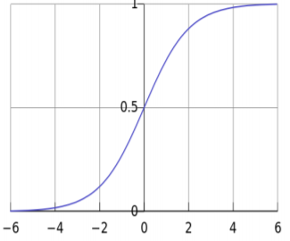
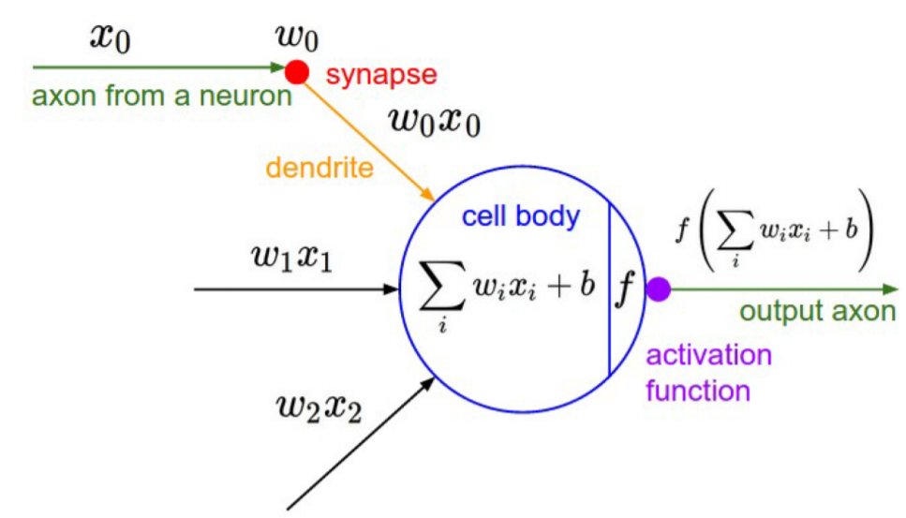
A neuron is equal to a binary logistic regression
Suppose activation function is equal to sigmoid.
$z=w^{T}x+b$
$f\left(z\right)=\frac{1}{1−\exp{(−z)}}$
Activation function is not limited to sigmoid.

Slide 8
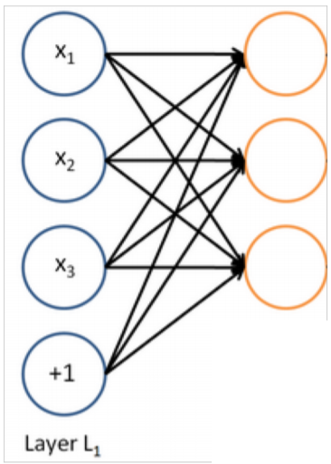
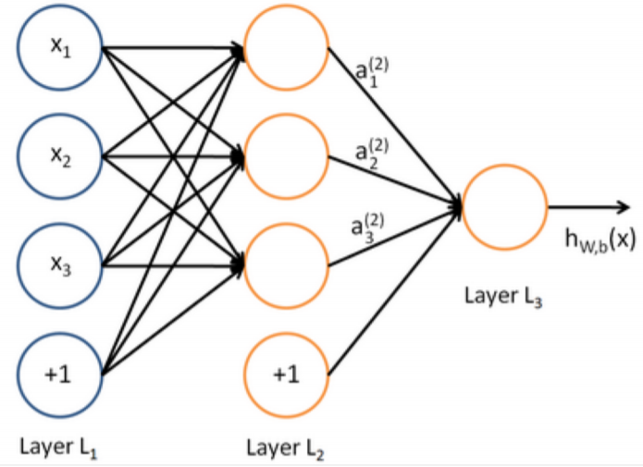
A neural network is equal to running many logistic regression simultaneously
Multi-layer Neural Network
Back-propagation determines the parameters in hidden layer to make a good decision.

Slide 9
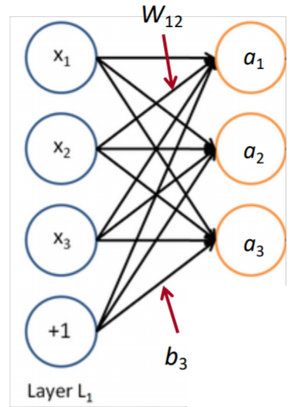
Matrix notation for a layer
$a_{1}=f(W_{11}x_{1}+W_{12}x_{2}$+$W_{13}x_{3}+b_{1}$)
…
Matrix Notation
z$=Wx+b$
a = f(z)
Activation function is element-wise
$f\left(\left[z_{1}{, z}_{2}{, z}_{3}\right]\right)=\left[{f(z}_{1}){, f(z}_{2}){, f(z}_{3})\right]$

Slide 10
Stochastic Gradient Decent

Slide 11
Stochastic Gradient Decent
Update Equation
$θ^{new}=θ^{old}−α∇_{θ}J\left(θ\right)$, where$α is$ learning rate.
The problem is how to compute $∇_{θ}J\left(θ\right)$.
By hand
Backpropagation
We will introduce tons of calculus later.

Slide 12
Calculus Review

Slide 13
Review of Calculus
Given $R→R$ function ${f\left(x\right)=3x}^{2},$ what is its slope / gradient?
$\frac{df}{dx}=6x$
Given $R^{n}→R$ function$,$ $f\left(x\right)= f\left(x_{1},x_{2},x_{3}\right)={x_{1}+x}_{2}^{2}+x_{3}^{3}$what is its gradient?
$\frac{∂f}{∂x}=\left[1, 2x_{2},{3x}_{3}^{2}\right]$
Formula for $R^{n}→R$ function$f\left(x\right)= f\left(x_{1},x_{2},…,x_{n}\right)$
$\frac{∂f}{∂x}=\left[\frac{∂f}{∂x_{1}},\frac{∂f}{∂x_{2}},…,\frac{∂f}{∂x_{n}}\right]$

Slide 14
Jacobian Matrix: Vectorized Gradients
We know how to compute gradients with respect to single parameters now.
However: It is not efficient enough.
Suppose we have a function $R^{n}→R^{m} f\left(x\right)=\left[f_{1}\left(x_{1}…x_{n}\right),f_{2}\left(x_{1}…x_{n}\right), …,f_{m}(x_{1}…x_{n})\right].$
The Jacobian is as follows.
$\frac{∂f}{∂x}=\left[\begin{matrix}\frac{∂f_{1}}{∂x_{1}} & … & \frac{∂f_{1}}{∂x_{n}} \\ ⋮ & ⋱ & ⋮ \\ \frac{∂f_{m}}{∂x_{1}} & … & \frac{∂f_{m}}{∂n}\end{matrix}\right]$

Slide 15
Chain Rule
The dot product of Jacobian Matrix
Suppose we have $h=f∘g$, where $∘$ is a composition operator.
Its derivative is as follows.
$J_{h(x)}=J_{f\left(g\left(x\right)\right)}∙J_{g(x)}$

Slide 16
Conventional Chain Rule
Suppose we have $f\left(\left(\begin{matrix}x_{1} \\ x_{2}\end{matrix}\right)\right)→{3x}_{1}+x_{2}^{2}$ and $g\left(\left(\begin{matrix}y_{1} \\ y_{2} \\ y_{3}\end{matrix}\right)\right)=(\left(\begin{aligned}y_{1}+{2y}_{2}+{3y}_{3} \\ y_{1}y_{2}y_{3}\end{aligned}\right))$, what is the gradients of h = f $∘$ g ?
h$\left(\left(\begin{matrix}y_{1} \\ y_{2} \\ y_{3}\end{matrix}\right)\right)=f\left(\left(\begin{aligned}y_{1}+{2y}_{2}+{3y}_{3} \\ y_{1}y_{2}y_{3}\end{aligned}\right)\right)=3\left(y_{1}+{2y}_{2}+{3y}_{3}\right)+{(y_{1}y_{2}y_{3})}^{2}$
$\frac{∂h}{∂y_{1}}\left(y\right)=3+2y_{1}y_{2}^{2}y_{3}^{2}$, $\frac{∂h}{∂y_{2}}\left(y\right)=6+2y_{2}y_{1}^{2}y_{3}^{2}$, $\frac{∂h}{∂y_{3}}\left(y\right)=9+2y_{3}y_{2}^{2}y_{1}^{2}$
so the gradients are
$∇_{y}h=\left[\begin{matrix}3+2y_{1}y_{2}^{2}y_{3}^{2} \\ 6+2y_{2}y_{1}^{2}y_{3}^{2} \\ 9+2y_{3}y_{2}^{2}y_{1}^{2}\end{matrix}\right]$

Slide 17
Multiplication of Jacobian Matrix Chain Rule
The same example as above let’s calculate chain rule with multiplication of Jacobian Matrix.
$∇_{x}f=\left(\begin{matrix}3 & {2x}_{2}\end{matrix}\right)$, $∇_{y}g=\left(\begin{matrix}\begin{matrix}1 & 2 & 3\end{matrix} \\ \begin{matrix}y_{2}y_{3} & y_{1}y_{3} & y_{1}y_{2}\end{matrix}\end{matrix}\right)$
$∇_{g(y)}f\left(\left(\begin{aligned}y_{1}+{2y}_{2}+{3y}_{3} \\ y_{1}y_{2}y_{3}\end{aligned}\right)\right)=\left(\begin{matrix}3 & 2y_{1}y_{2}y_{3}\end{matrix}\right)$
$∇_{y}h={∇_{g(y)}f}^{T}∙∇_{y}g=\left[\begin{matrix}3 & 2y_{1}y_{2}y_{3}\end{matrix} \right]$ $∙\left(\begin{matrix}\begin{matrix}1 & 2 & 3\end{matrix} \\ \begin{matrix}y_{2}y_{3} & y_{1}y_{3} & y_{1}y_{2}\end{matrix}\end{matrix}\right)$

Slide 18
Useful Identities for Neural Network

Slide 19
Matrix Times Column Vector w.r.t. Column Vector
z = Wx, what is $\frac{∂z}{∂x}$ ? W $ε R^{n∗m}$, x $ε R^{m}$
z = $\left[\begin{matrix}W_{11}x_{1}+W_{12}x_{2}+…+W_{1m}x_{m} \\ ⋮ \\ W_{n1}x_{1}+W_{n2}x_{2}+…+W_{nm}x_{m}\end{matrix}\right]$
$\frac{∂z}{∂x}=\left[\begin{matrix}W_{11} & … & W_{1m} \\ ⋮ & ⋱ & ⋮ \\ W_{n1} & … & W_{nm}\end{matrix}\right]$ = W – (1)

Slide 20
Row Vector Times Matrix w.r.t. Row Vector
z = xW, what is $\frac{∂z}{∂x}$ ? W $ε R^{n∗m}$, x $ε R^{1∗n}$
z = $\left[\begin{matrix}{x_{1}W}_{11}+{x_{2}W}_{21}+…+{x_{n}W}_{n1} \\ ⋮ \\ {x_{1}W}_{1m}+{x_{2}W}_{2m}+…+{x_{n}W}_{nm}\end{matrix}\right]$
$\frac{∂z}{∂x}=\left[\begin{matrix}W_{11} & … & W_{n1} \\ ⋮ & ⋱ & ⋮ \\ W_{1m} & … & W_{nm}\end{matrix}\right]$ = $W^{T}$ – (2)

Slide 21
A Vector w.r.t. Itself
z = x, what is $\frac{∂z}{∂x}$ ?
z = $\left[\begin{matrix}\begin{aligned}x_{1} \\ x_{2}\end{aligned} \\ ⋮ \\ x_{m}\end{matrix}\right]$
$\frac{∂z}{∂x}$ = $\left[\begin{matrix}\begin{aligned}10⋯0 \\ 0 1⋯0\end{aligned} \\ ⋮ \\ 00⋯1\end{matrix}\right]$ = I
Thus, $\frac{∂z}{∂x}$ = I, which is an identity matrix. – (3)

Slide 22
Elementwise Function
z = f(x), what is $\frac{∂z}{∂x}$ ?
$\text{z}\text{ = }\left[\begin{matrix}\begin{aligned}{f(x}_{1}) \\ {f(x}_{2})\end{aligned} \\ ⋮ \\ {f(x}_{m})\end{matrix}\right]$
$\frac{∂z}{∂x}$ = $\left[\begin{matrix}\begin{aligned}f^{′}(x_{1}) \\ f^{′}(x_{2})\end{aligned} \\ ⋮ \\ f^{′}(x_{m})\end{matrix}\right]$
Thus, $\frac{∂z}{∂x}$ = diag($f^{′}(x)$) – (4)

Slide 23
Matrix Times Column Vector w.r.t Matrix
z = Wx, $δ=\frac{∂J}{∂z}$, what is $\frac{∂J}{∂W}$ ? W $ε R^{n∗m}$, x $ε R^{m}$
z = $\left[\begin{matrix}{x_{1}W}_{11}+{x_{2}W}_{12}+…+{x_{m}W}_{1m} \\ ⋮ \\ {x_{1}W}_{n1}+{x_{2}W}_{n2}+…+{x_{m}W}_{nm}\end{matrix}\right]$
$\frac{∂J}{∂w_{11}}= \frac{∂J}{∂z}$ * $\frac{∂z}{∂w_{11}}$ = $\left[\begin{matrix}\frac{∂J}{∂z_{1}} \\ ⋮ \\ \frac{∂J}{∂z_{n}}\end{matrix}\right]$ * $\left[\begin{matrix}\begin{aligned}x_{1} \\ 0\end{aligned} \\ ⋮ \\ 0\end{matrix}\right]$ =$\frac{∂J}{∂z_{1}}$ * $x_{1}$
….
m - 1

Slide 24
Matrix Times Column Vector w.r.t Matrix
Therefore, $\frac{∂J}{∂W}$ = $\left[\begin{matrix}\frac{∂J}{∂z_{1}}\text{ ∗ }x_{1} ,\frac{∂J}{∂z_{1}}\text{ ∗ }x_{2},…,\frac{∂J}{∂z_{1}}\text{ ∗ }x_{m} \\ ⋮ \\ \frac{∂J}{∂z_{n}}\text{ ∗ }x_{1} ,\frac{∂J}{∂z_{n}}\text{ ∗ }x_{2},…,\frac{∂J}{∂z_{n}}\text{ ∗ }x_{m}\end{matrix}\right]$ = $\left[\begin{aligned}\frac{∂J}{∂z_{1}} \\ ⋮ \\ \frac{∂J}{∂z_{n}}\end{aligned}\right]$ [$x_{1}$, $…$, $x_{m}$] =$δ$ $x^{T}$

Slide 25
Derivative of Cross-Entropy Loss w.r.t x
J = $−\log\left(p\left(y | x\right)\right)=−log⁡\left(\frac{\exp\left(W_{y}x\right)}{\sum_{c=1}^{C}{{exp⁡(W}_{c}x)}}\right)$, what is $\frac{∂J}{∂x}?$
J = -$W_{y}x$ + $log⁡\left(\sum_{c=1}^{C}{{exp⁡(W}_{c}x)}\right)$
$\frac{∂J}{∂x}$= -$W_{y}$+$\frac{\exp\left(W_{y}x\right)}{\sum_{c=1}^{C}{{exp⁡(W}_{c}x)}}W_{y}$
Identity 1

Slide 26
Derivative of Cross-Entropy Loss
J = $−log⁡\left(\frac{\exp\left(z_{i}\right)}{\sum_{c=1}^{C}{{exp⁡(z}_{c})}}\right)$, what is $\frac{∂J}{∂z_{i}}?$
J = -$z_{i}$+ $log⁡\left(\sum_{c=1}^{C}{{exp⁡(z}_{c})}\right)$
$\frac{∂J}{∂z_{i}}$ = -1 + $\frac{\exp\left(z_{i}\right)}{\sum_{c=1}^{C}{{exp⁡(z}_{c})}}$
= -1 + softmax($z_{i}$)

Slide 27
Derivative of Sigmoid Function
f(z) = $\frac{1}{1−\exp{(−z)}}$, what is $\frac{∂f}{∂z}?$
$\frac{∂f}{∂z}=\frac{−exp⁡(−z)}{{\left[1−\exp{(−z)}\right]}^{2}}$
= $\frac{−\exp\left(−z\right)+1 −1}{{\left[1−\exp{(−z)}\right]}^{2}}$
= $\frac{1}{1−\exp{(−z)}}$ * $\frac{−\exp\left(−z\right)+1 −1}{1−\exp{(−z)}}$
= $\frac{1}{1−\exp{(−z)}}∗\left[1+\left(\frac{−1}{1−\exp{(−z)}}\right)\right]$
= $σ\left(z\right)∗\left[1−σ\left(z\right)\right]$

Slide 28
Derivative of ReLU Function
ReLU(x) = max(0,x), 求 ReLU 的微分
${ReLU}^{′}\left(x\right)=\left\{\begin{aligned}1, ifx>0 \\ 0, otherwise\end{aligned}\right.$

Slide 29
Derivative of Tanh Function
Tanh(z) =$\frac{\exp\left(z\right)−\exp\left(−z\right)}{\exp\left(z\right)+\exp\left(−z\right)}$ , 求Tanh的微分
${\text{Tanh}}^{′}\left(z\right)=\frac{\left[\exp\left(z\right)+\exp\left(−z\right)\right]∗\left[\exp\left(z\right)+\exp\left(−z\right)\right] −\left[\exp\left(z\right)−\exp\left(−z\right)\right]∗\left[\exp\left(z\right)−\exp\left(−z\right)\right]}{{\left[\exp\left(z\right)+\exp\left(−z\right)\right]}^{2}}$
= $\frac{{\left[\exp\left(z\right)+\exp\left(−z\right)\right]}^{2} −{\left[\exp\left(z\right)−\exp\left(−z\right)\right]}^{2}}{{\left[\exp\left(z\right)+\exp\left(−z\right)\right]}^{2}}$
= 1 - ${\text{Tanh}}^{2}\left(z\right)$

Slide 30
Backpropagation

Slide 31
Introduction
Derivative
Chain rule
In order to minimize computation, we also reuse the derivative from higher layer.

Slide 32
Computational Graph and Forward Propagation
Forward Propagation
x (input)
z = Wx + b
h = f(z)
s = $uh$

Slide 33
Computational Graph and Back Propagation
Forward Propagation
x (input)
z = Wx + b
h = f(z)
s = $u^{T}h$

Slide 34
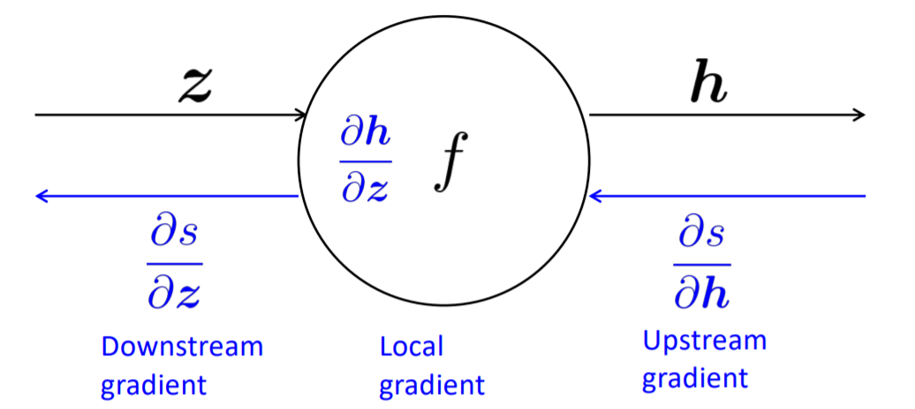
Backpropagation on Single Node
Each node
receives the upstream gradient
has a local gradient

Slide 35
How to calculate $\frac{∂s}{∂z}$?
$\frac{∂s}{∂z}=$ $\frac{∂s}{∂h} \frac{∂h}{∂z}$
(downstream gradient) = (upstream gradient) (local gradient)

Slide 36
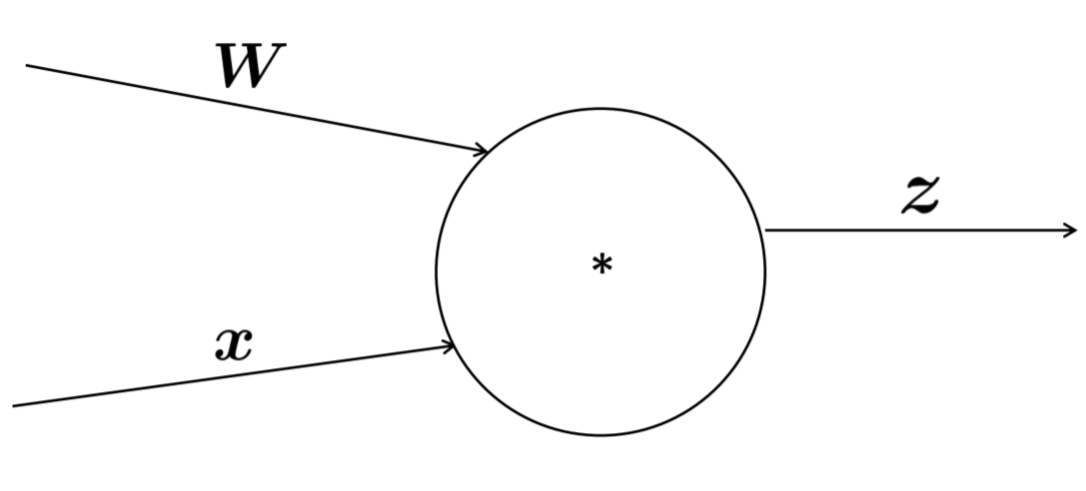
Single Node with Multiple Inputs
z = Wx
Multiple Inputs multiple local gradients
$$\frac{∂s}{∂W}=\frac{∂s}{∂z}\frac{∂z}{∂W}$$
$$\frac{∂z}{∂W}$$
$$\frac{∂z}{∂x}$$
$$\frac{∂s}{∂z}$$
$$\frac{∂s}{∂x}=\frac{∂s}{∂z}\frac{∂z}{∂x}$$

Slide 37
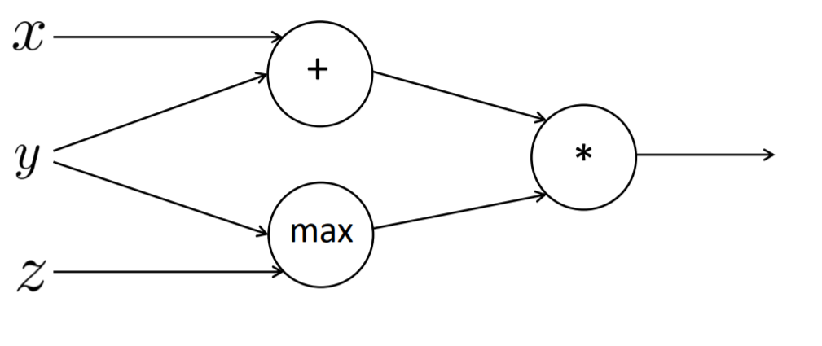
Example
Forward Propagation
a = x + y = 3
b = max(y, z) = 2
f = ab = 6
x = 1, y = 2, z = 0
$\frac{∂f}{∂x}=2$
$\frac{∂f}{∂y}=2+3=5$
$\frac{∂f}{∂z}=0$
1
$$\frac{∂f}{∂x}=2∗1$$
3
2
$$\frac{∂f}{∂y}=2∗1$$
$$\frac{∂f}{∂a}=1∗2$$
6
2
$$\frac{∂f}{∂f}=1$$
$$\frac{∂f}{∂y}=3∗1$$
2
$$\frac{∂f}{∂b}=1∗3$$
0
$$\frac{∂f}{∂z}=1∗0$$

Slide 38
Sum up the Gradients at outward Branches

Slide 39
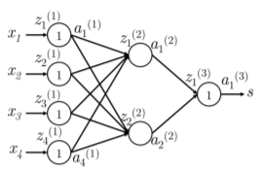
Real Network Example
We will calculate $\frac{∂s}{∂W_{ij}^{(1)}}$
$\frac{∂s}{∂W_{ij}^{(1)}}=\frac{∂W^{(2)}a^{(2)}}{∂W_{ij}^{(1)}}=\frac{∂W_{i}^{(2)}a^{(2)}}{∂W_{ij}^{(1)}}=W_{i}^{(2)}\frac{∂a^{(2)}}{∂W_{ij}^{(1)}}$
${=W}_{i}^{(2)}\frac{∂a^{(2)}}{∂W_{ij}^{(1)}}=W_{i}^{(2)}\frac{∂a^{(2)}}{∂z_{i}^{(2)}}\frac{∂z_{i}^{(2)}}{∂W_{ij}^{(1)}}$
$=W_{i}^{(2)}\frac{∂{f(z}_{i}^{(2)})}{∂z_{i}^{(2)}}\frac{∂z_{i}^{(2)}}{∂W_{ij}^{(1)}}$
$$δ_{i}^{(2)}$$

Slide 40
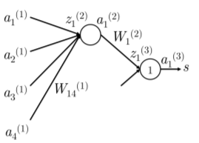
How to calculate $\frac{∂z_{i}^{(2)}}{∂W_{ij}^{(1)}}$?
$\frac{∂z_{i}^{(2)}}{∂W_{ij}^{(1)}}=\frac{∂}{∂W_{ij}^{(1)}}\left(a_{1}^{(1)}W_{i1}^{(1)}+a_{2}^{(1)}W_{i2}^{(1)}+a_{3}^{(1)}W_{i3}^{(1)}+a_{4}^{(1)}W_{i4}^{(1)}\right)$
=$\frac{∂}{∂W_{ij}^{(1)}}\left(\sum_{k}{a_{k}^{(1)}W_{ik}^{(1)}}\right)$
=$a_{j}^{(1)}$

Slide 41
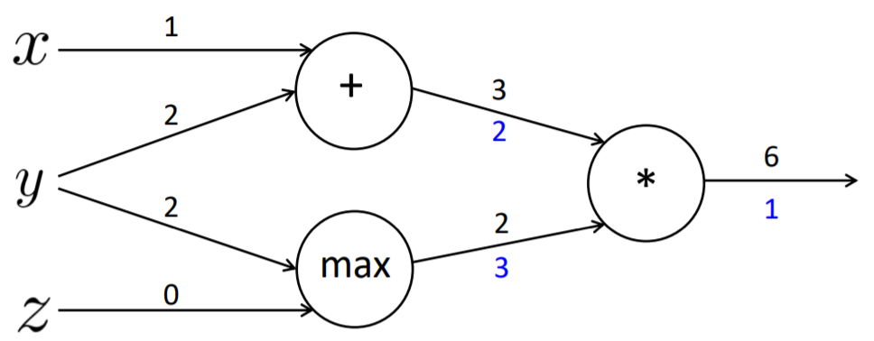
Node Intuition
Upstream gradient is distributed when the node is “+”
Upstream gradient is routed when sign of node is “max”
Upstream gradient is switched when sign of node is ”*”

Slide 42
Efficient Gradient Computation
Incorrect Way to Compute backprop
Compute backprop without reusing the term that has already calculated

Slide 43
Efficient Gradient Computation
Right way to compute backprop
Reuse the gradients which we have already calculated.

Slide 44
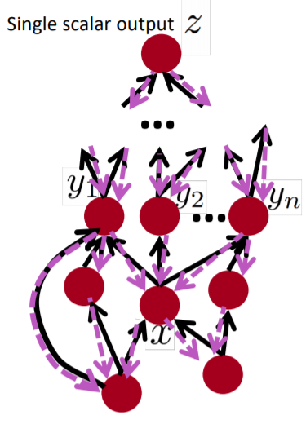
Backprop in Computational Graph
Nodes are sorted in topological sort. Then,
Forward propagation
Values are computed in topological sort.
Backward propagation
Output gradient is initialized to 1
Nodes are visited in reversed topological order
$\frac{∂z}{∂x}=\sum_{i=1}^{n}{\frac{∂z}{∂y_{i}}\frac{∂y_{i}}{∂x}}$
Algorithm complexity of both algorithm is the same if we compute correctly.

Slide 45
Implementation of Back-Prop

Slide 46
Implementation of Forward/Backward API

Slide 47
Implementation of Forward/Backward API

Slide 48
Numeric Gradient for Gradient Check
For small h ($≈{10}^{−4}), f^{′}(x)≈\frac{f\left(x+h\right)−f(x−h)}{2h}$
Why above formula rather than previous formula that we learn in calculus class?
Numeric Gradient is
Hard to implement incorrectly
Very slow
Useful to check our gradient
Requirement to run gradient check become less nowadays

Slide 49
Summary
For now we have learnt
Neural network
Core technology of neural network (backpropagation, partial derivative, chain rule, Jacobian, computational graph)
But why should we learn it?
Know how to debug when our neural nets don’t run correctly
Know how it works so that we can do further research
Spot dead network (ReLU)
Vanish gradient

Slide 50
Tricks and Tips on Neural Network

Slide 51
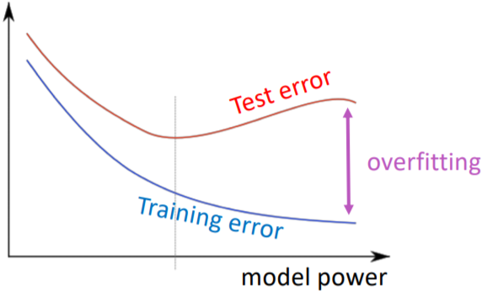
Regularization
In order to prevent overfitting, our loss function will be as follows in practice.
$J\left(θ\right)=\frac{1}{N}\sum_{i=1}^{N}{−\log\left(\frac{\exp{(f_{yi})}}{\sum_{c=1}^{C}{\exp{(f_{c})}}}\right)}+λ\sum_{k}{θ_{k}^{2}}$
Some people may say it’s better to have ten
times less parameters than the data.
However: Deep learning often has ten times much
parameters than data, it works well.
We have many techniques to do the
regularization
L2 Regularization
Hyper-Parameter

Slide 52
$$\text{Regularization}: λ$$
If$λ$ is
Too high: training step will be trivial because almost all of weights are 0.
Too Low: model will be overfitting again since it’s similar to no regularization.
$λ$ is a hyper-parameter that is required fine-tune.

Slide 53
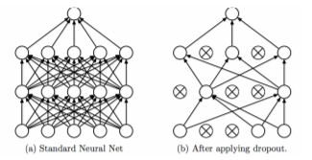
Dropout
A powerful and effective regularization technique.
Training Step: Only probability p number of neurons are activated.
Test Step: Full neurons are activated.

Slide 54
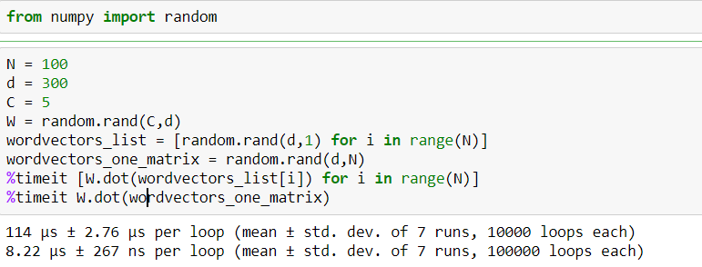
Vectorization
This code is only run by using CPU. However, GPU can be faster.

Slide 55
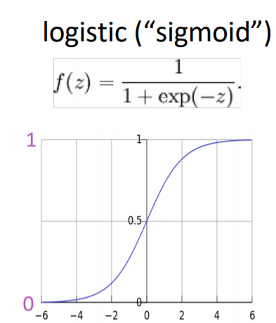
Non-Linearity: Sigmoid
It was commonly used in early 80’s and 90’s.
Its output gives us a probability because its
rank is between 0 and 1.
Since it doesn’t work well, we seldom use it
nowadays. This non-linearity is employed when
we want our output to be a probability.

Slide 56
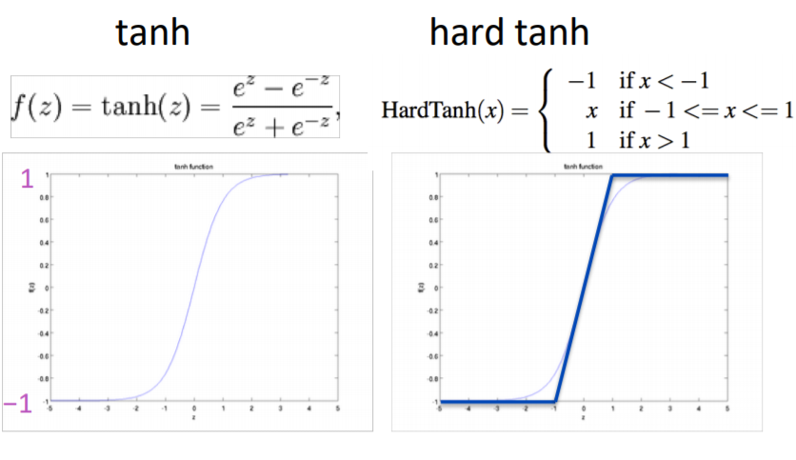
Non-Linearities: tanh and hard tanh
tanh(z) =2 sigmoid(2z)-1
None of above non-linearities are default choices for training neural network.

Slide 57
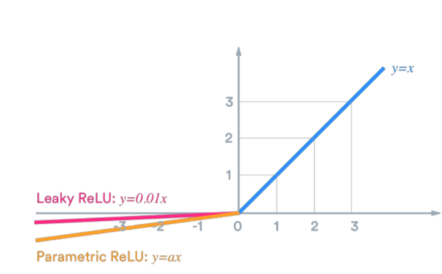
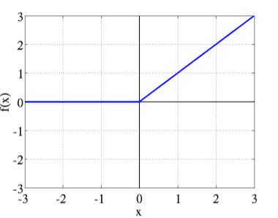
Better Non-Linearity
ReLU = max(z,0)
Computational efficiency
Dead network sometimes
Leaky ReLU and Parametric ReLU
It’s better to try ReLU first.

Slide 58
Non-Linearity: Maxout
$maxout=max⁡(w_{1}^{T}x+b_{1},w_{2}^{T}x+b_{2})$
Advantage
Doesn’t have dying ReLU
Disadvantage
Double the parameter

Slide 59
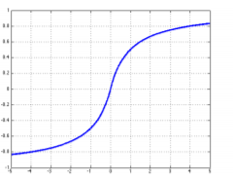
Non-Linearity: Soft Sign
softsign(z) = $\frac{z}{1+\left|z\right|}$

Slide 60
Derivative of Non-Linearities
tanh(z)=$\frac{\exp\left(z\right)−exp⁡(−z)}{\exp\left(z\right)+exp⁡(−z)}$
$hardtanh\left(z\right)=\left\{\begin{aligned}−1 :z<−1 \\ z :−1<z<1 \\ 1 :z>1\end{aligned}\right.$
$softsign\left(z\right)=\frac{z}{1+\left\lfloor z\right\rfloor }$
ReLU(z) =max(z,0)
Leaky ReLU(z) = max(z,k*z)
$\tanh^{′}\left(z\right)=1−\tanh^{2}(z)$
${hardtanh}^{′}\left(z\right)=\left\{\begin{aligned}1 :−1<z<1 \\ 0 :otherwise\end{aligned}\right.$
${softsign}^{′}\left(z\right)=\frac{1}{{(1+z)}^{2}}$
${rect}^{′}\left(z\right)=\left\{\begin{aligned}1 :z>0 \\ 0 :otherwise\end{aligned}\right.$
${leaky}^{′}\left(z\right)=\left\{\begin{aligned}1 :z>0 \\ k :otherwise\end{aligned}\right.$

Slide 61
Data Preprocessing
Mean Subtraction
Calculate the mean in training data and subtract this mean from input.
Although mean is only calculated in training set, this mean is subtracted from training, test, and validation sets.
Normalization
Normalization, which features are divided by the standard deviation calculated by using training sets, scales range between input data in order to equalize the importance of all features.

Slide 62
Parameter Initialization
In order to avert symmetries, weights are initialized to small random values.
Bias terms are initialized to 0 and makes the network learn itself.
Xavier initialization suggests that we can randomly initialize the weights with the following uniform distribution.
Xavier lower the error rate and converge faster.
$$W\sim U\left[−\sqrt{\frac{6}{n_{in}+n_{out}}},\sqrt{\frac{6}{n_{in}+n_{out}}}\right]$$

Slide 63
Optimizer
Result of plain SGD is usually fine although it requires to hand-tuning the learning rate
Other optimizer that adjusts the parameter automatically.
Adagrad
RMSprop
Adam
SparseAdam
…
It’s good to begin with Adam optimizer.

Slide 64
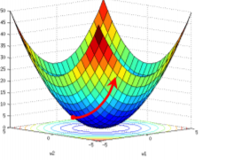
Learning Rate
Magnitude of Learning Rate
Too big: will not converge
Too small: train like a baby
It’s common to try power of 10.
It’s better to diminish the learning rate when we train the model. There are some ways decreasing learning rate. They’re illustrated as follows.
By hand: to halve the learning rate each k epochs
By formula: lr=${lr}_{0}e^{−kt}$, for epoch t, k is a hyper-parameter
By formula: lr$=\frac{{lr}_{0}τ}{max⁡(t,τ)}$,$τ$ is a hyper-parameter
Cyclic Learning Rate
Fancier optimizer will shrink the learning. Hence, it’s better to start high such as 0.1.

Slide 65
Reference
Manning et al., CS224n Natural Language Processing with Deep Learning, Stanford University
Mundra et al., Stanford University : Lecture 2 Notes
Li et al., CS231n Convolutional Neural Networks for Visual Recognition, Stanford University
Guillaume Genthial, Review of differential calculus theory, Stanford University
Kevin Clark, Computing Neural Network Gradients, Stanford University

